Slide 1
Polarization-based dehazing using two reference objects
Daisuke Miyazaki Daisuke Akiyama
Masashi Baba Ryo Furukawa
Shinsaku Hiura Naoki Asada

Slide 2

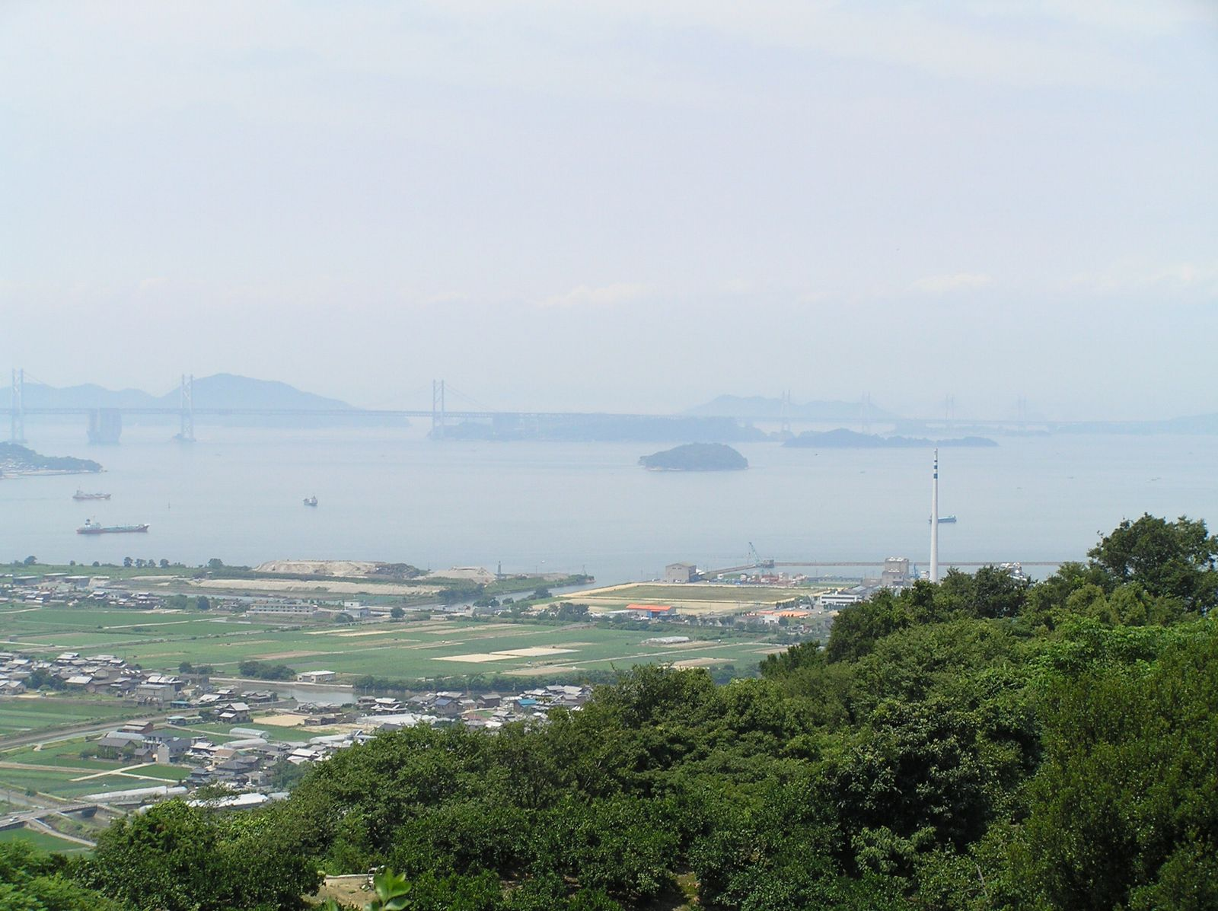
Background
Introduction(1/3)
Proposed method(7)
Experiment(6)
Discussion(2)
Ah... I’m scared of driving under hazy weather...
Hiroshima (Japan) has lots of fogs and yellow dusts...

Slide 3






Overview
Introduction(2/3)
Proposed method(7)
Experiment(6)
Discussion(2)
2
2
Attenuation
parameters
argmin
Attenuation
parameters
Input
Reference
Input
Reference
Input
(Hazy image)
Output
(Dehazed image)

Slide 4

Related work
Introduction(3/3)
Proposed method(7)
Experiment(6)
Discussion(2)
Our approach
Intensity-based
  [Narasimhan, Nayar 2000]
  [Tan 2008]
  [Fattal 2008]
  [He, Sun, Tang 2011]
Polarization-based
  [Schechner, Narasimhan, Nayar 2003]
  [Schechner, Karpel 2005]
  [Shwartz, Namer, Schechner 2006]
  [Treibitz, Schechner 2009]
(After parameter estimation [off-line process])
Haze can be removed in real-time
Theory is physics-based thus
reliable

Slide 5
Polarization
Introduction(3)
Proposed method(1/7)
Experiment(6)
Discussion(2)
Light is electro-magnetic wave
Polarization = light oscillated non-uniformly
Unpolarized light
Perfect linear polarization

Slide 6
Observed light
Introduction(3)
Proposed method(2/7)
Experiment(6)
Discussion(2)
Observed light
Scattered light
Object light
Attenuated object light
Haze
(Observed light) = (Scattered light) + (Attenuated object light)

Slide 7
Polarization of scattered light
Introduction(3)
Proposed method(3/7)
Experiment(6)
Discussion(2)
Sun
Unpolarized
Scattering
Partially
polarized
light
Component parallel to scattering plane (superscript: )
Component perpendicular to scattering plane (superscript: )

Slide 8
Formulation of observed light
Introduction(3)
Proposed method(4/7)
Experiment(6)
Discussion(2)
Light
source
Haze
Maximum scattered light
A
∞
Distance
∞
Observed
light
Scattered light
A
Camera
I
Attenuated object light
T
Attenuation
exp(-βZ)
Object
Distance
Z
Object light
R
Camera

Slide 9
Concept of parameter estimation
Introduction(3)
Proposed method(5/7)
Experiment(6)
Discussion(2)
Reference objects
Captured image

Slide 10
Parameter estimation from two references
Introduction(3)
Proposed method(6/7)
Experiment(6)
Discussion(2)
Observed light
Haze
Input:
I
Output:
1p
Traffic
sign 1
Traffic
sign 2
Camera
Observed light
Distance
Z
1
I
2q
Distance
Z
2
Object light
R
1p
Traffic
sign 1
Traffic
sign 2
Camera
Levenberg-Marquardt method
Object light
for 8bit camera
R
2q
[Initial value]

Slide 11
Related work
Introduction(3)
Proposed method(7/7)
Experiment(6)
Discussion(2)
[Schechner 2003] use sky region as A∞
A
∞
Reason 1: Stratosphere is far
Reason 2: Universe is dark
If sky is unobserved...
If mountain boundary undetected...

Slide 12
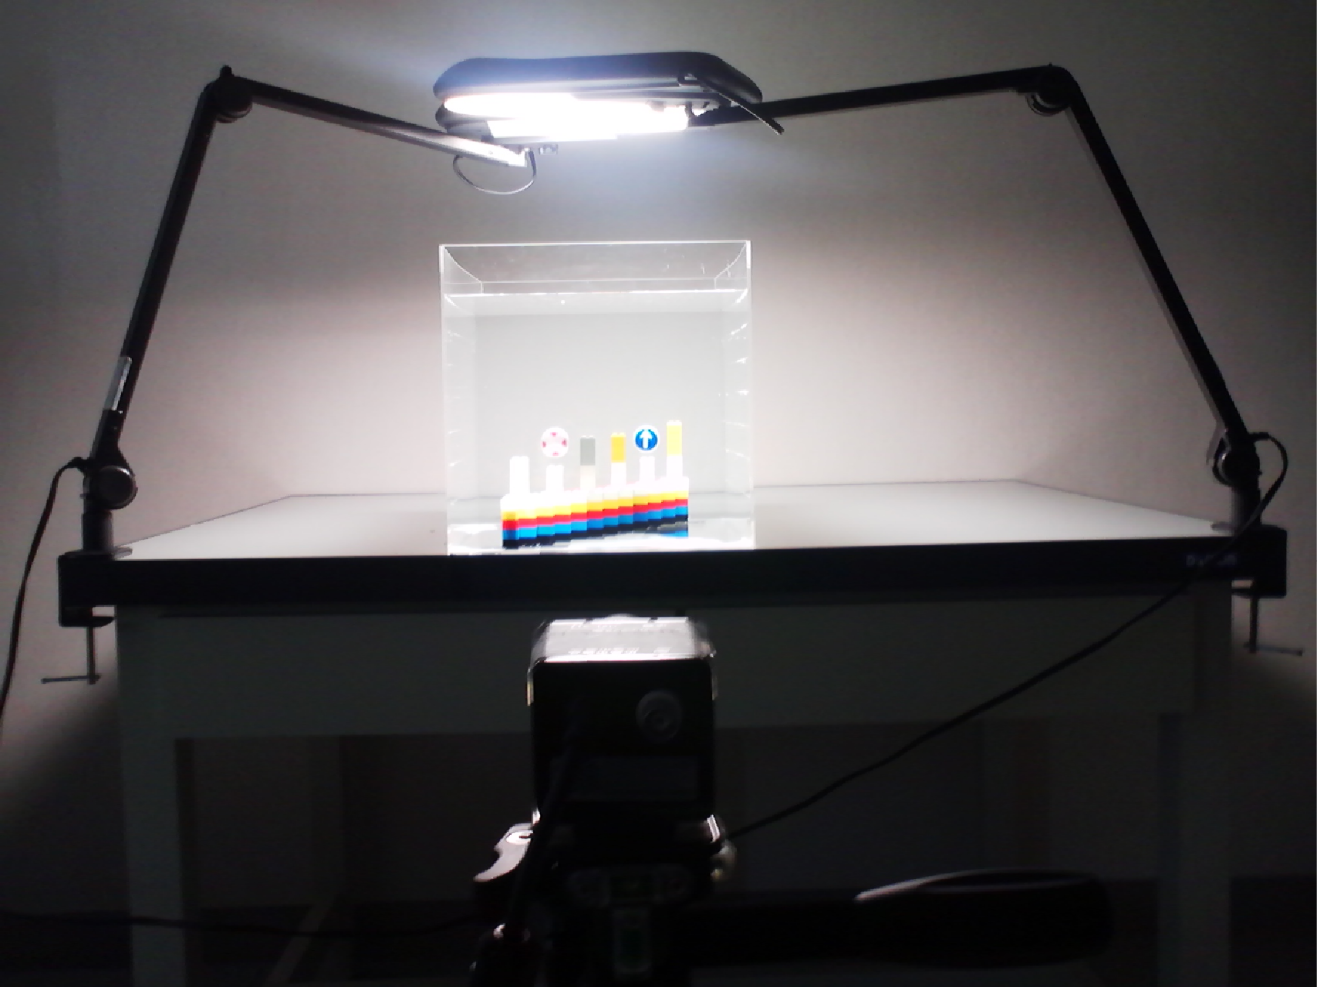
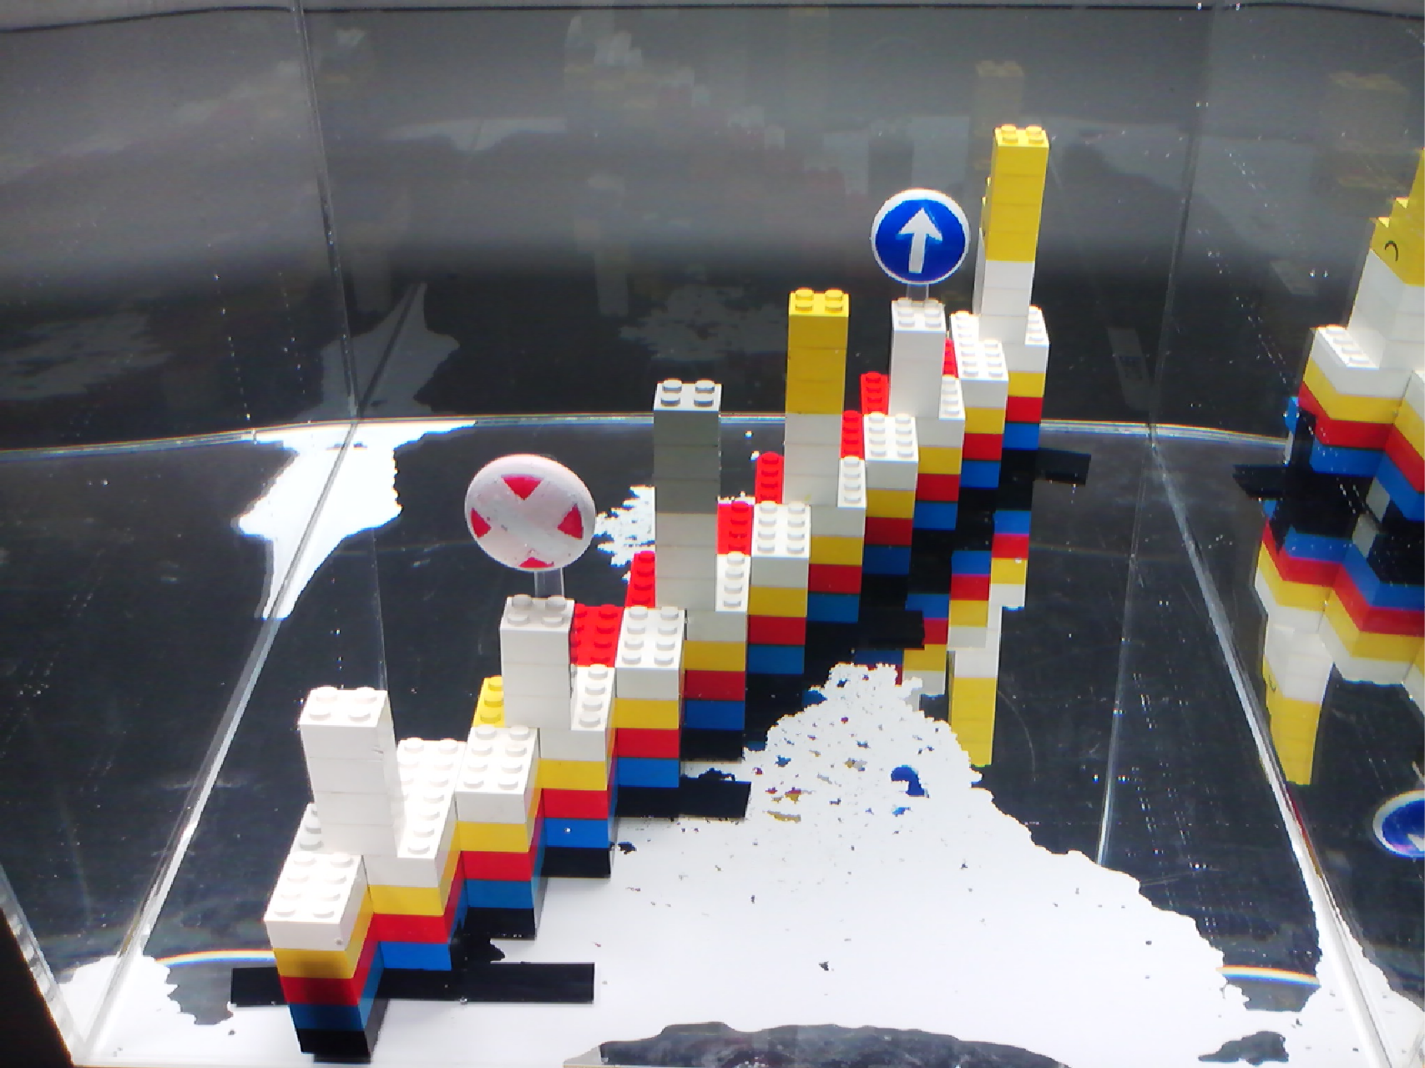
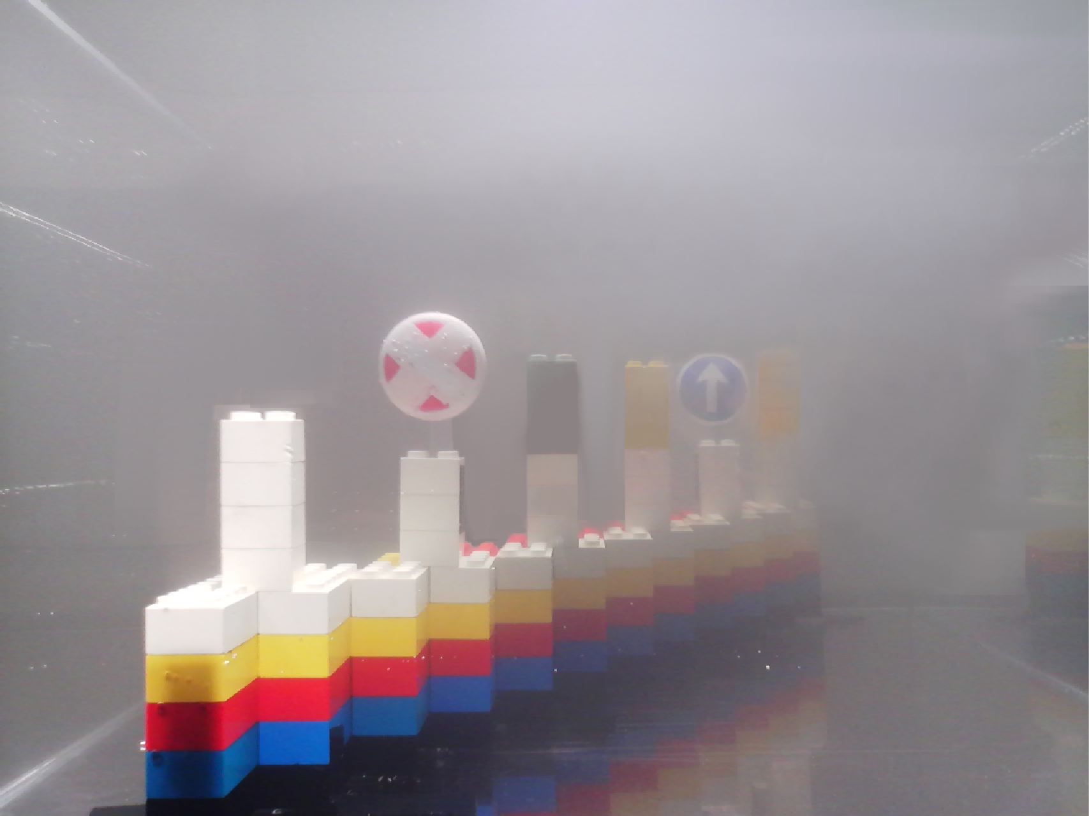
Experimental setup
Introduction(3)
Proposed method(7)
Experiment(1/6)
Discussion(2)
Light
Traffic sign 2
Water tank
Traffic sign1
Polarization camera
Black paint particle scatters the light

Slide 13
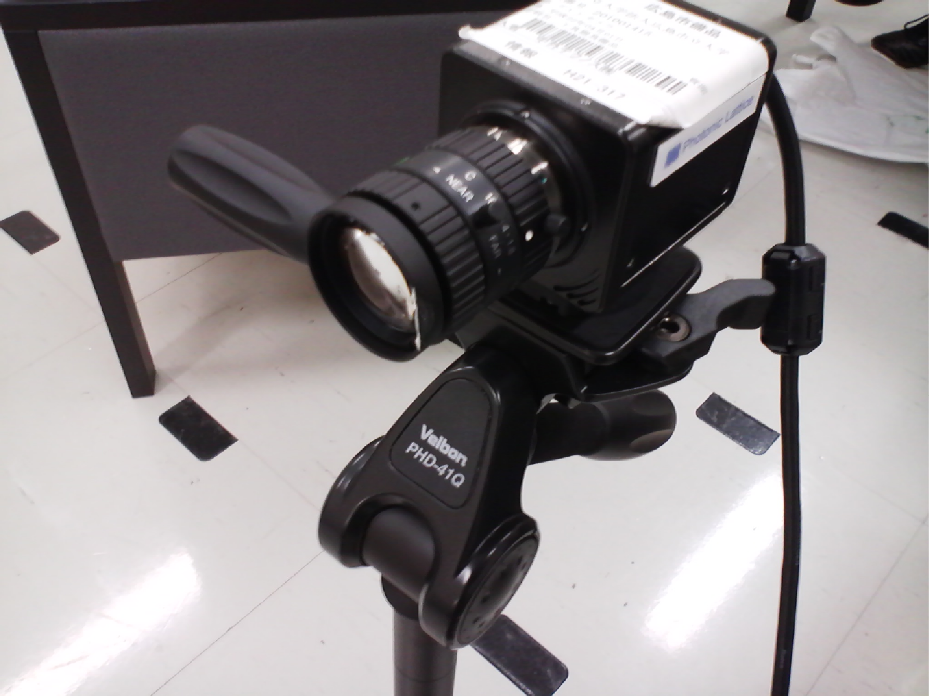
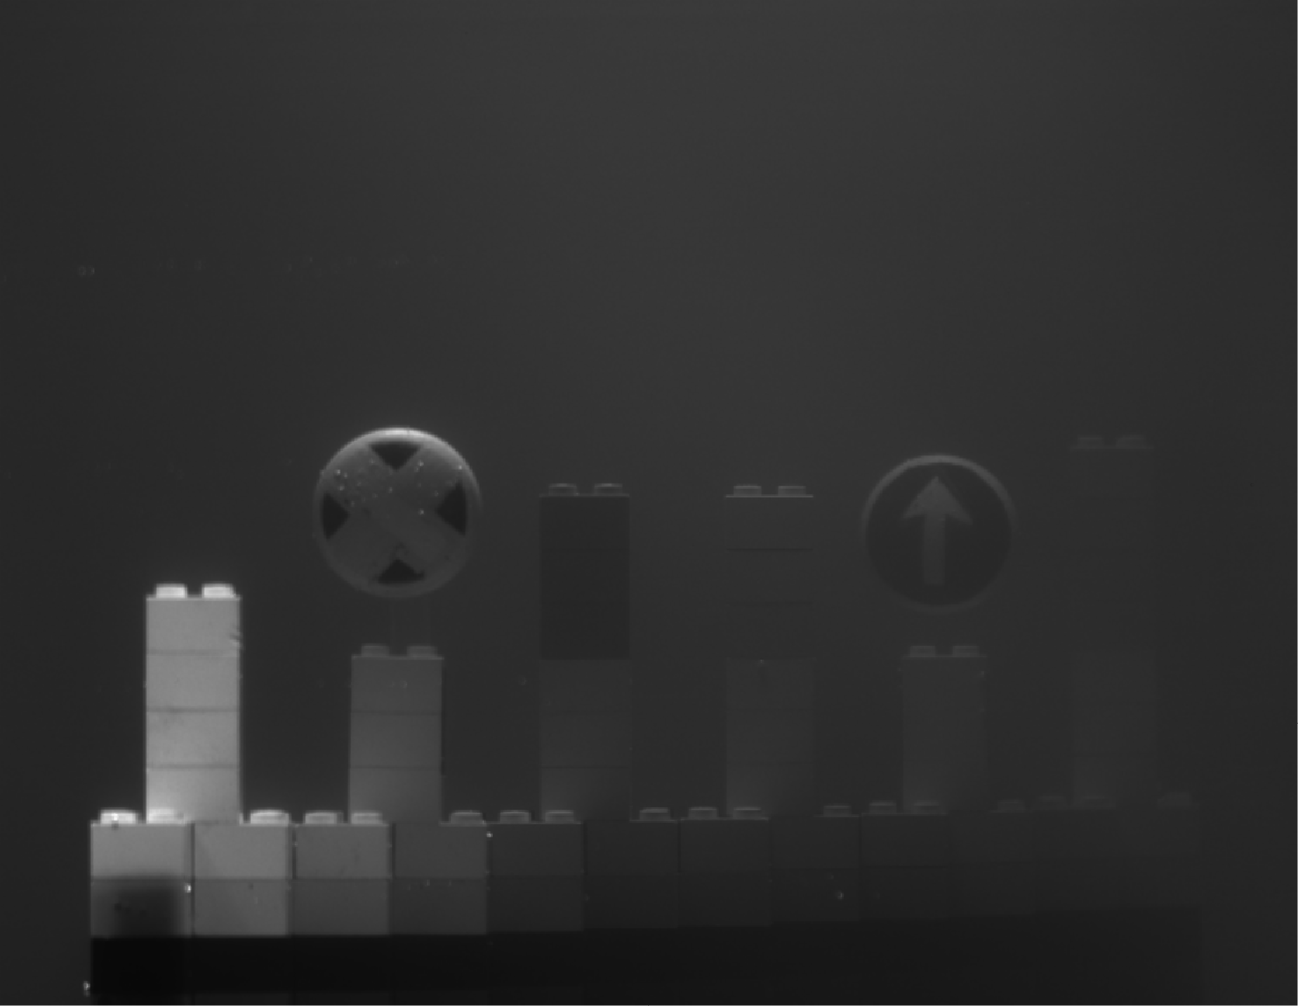

Captured images
Introduction(3)
Proposed method(7)
Experiment(2/6)
Discussion(2)
Realtime
monochrome
polarization
camera
Input I_{max}
(related to )
Input I_{min}
(related to )

Slide 14
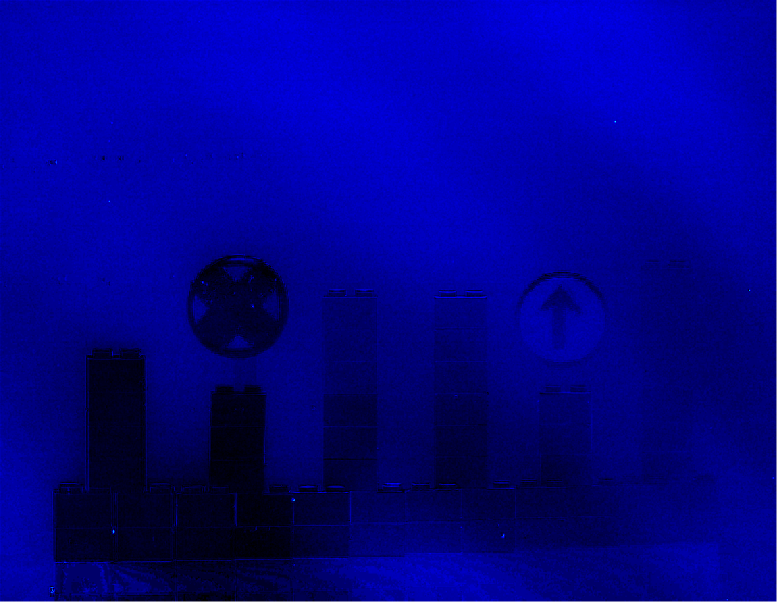
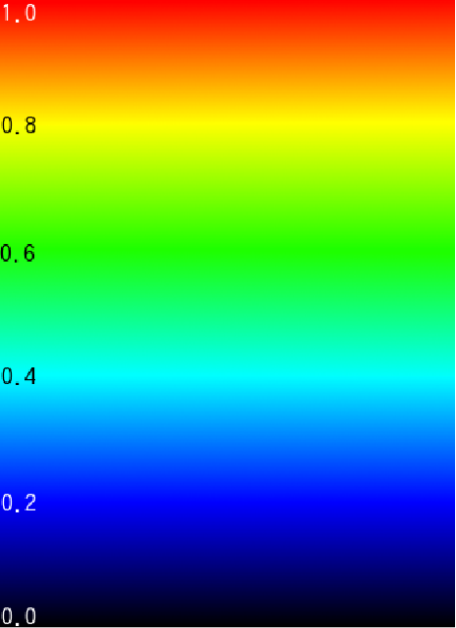
Degree of polarization
Introduction(3)
Proposed method(7)
Experiment(3/6)
Discussion(2)
Degree of polarization
1
0

Slide 15

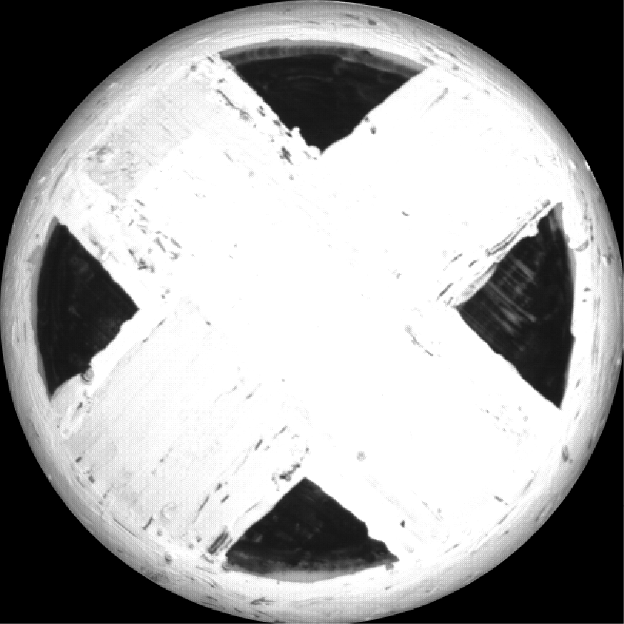
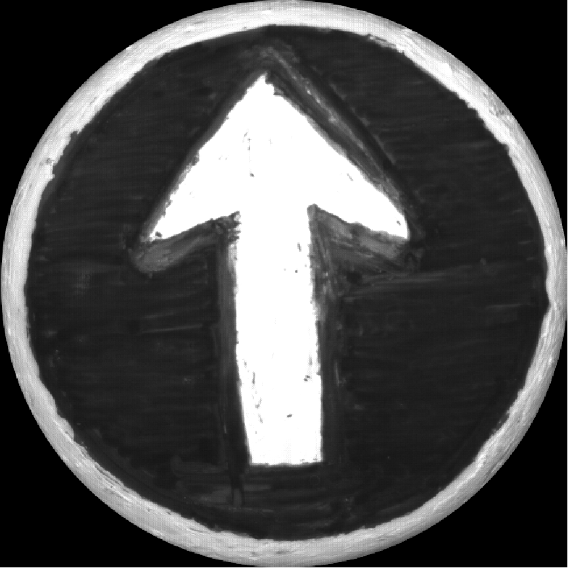
Two reference objects
Introduction(3)
Proposed method(7)
Experiment(4/6)
Discussion(2)
Reference image
Estimated
parameters

Slide 16
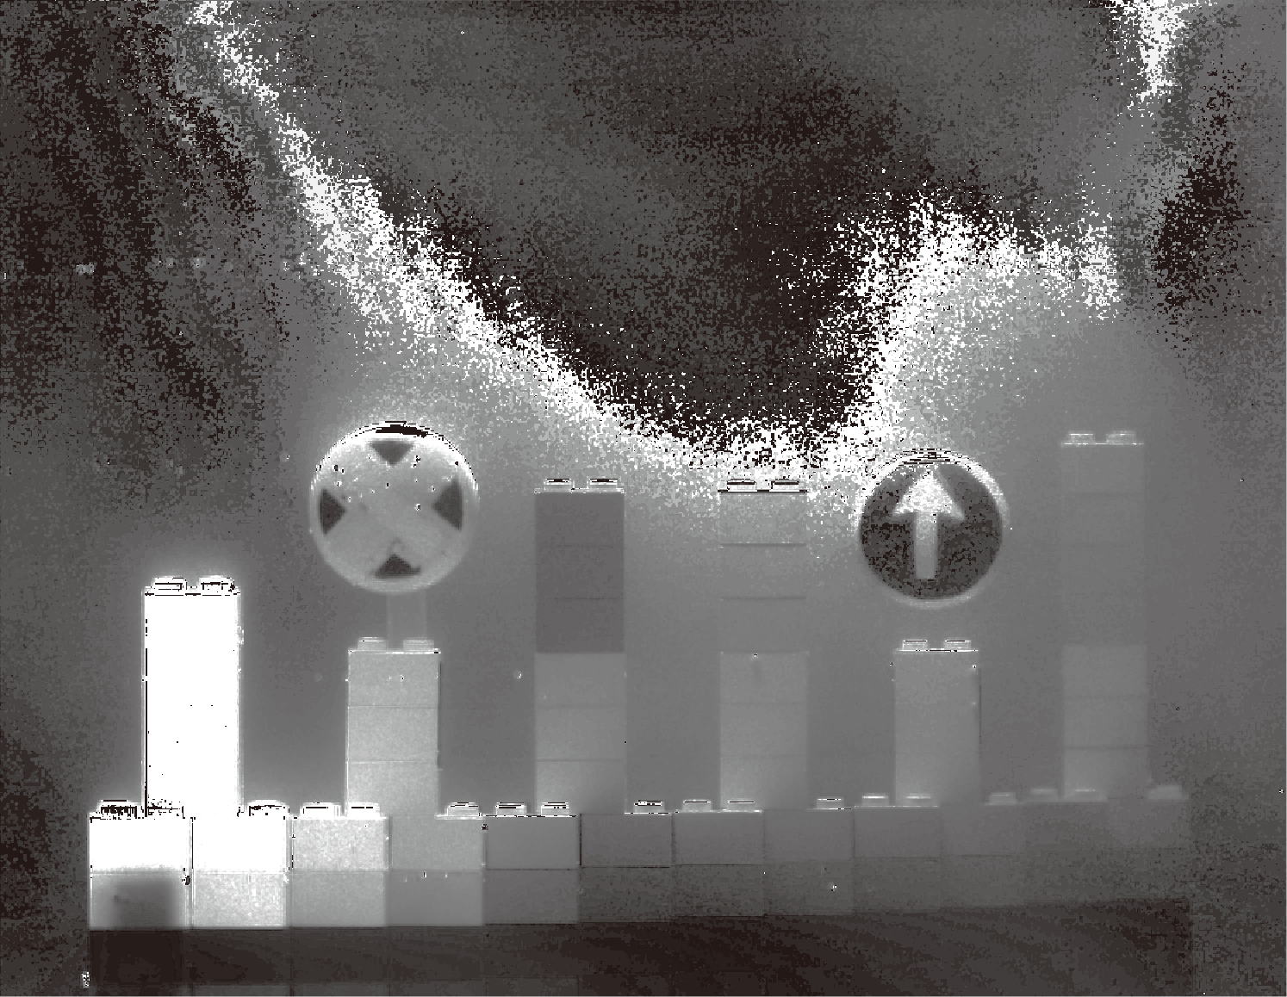
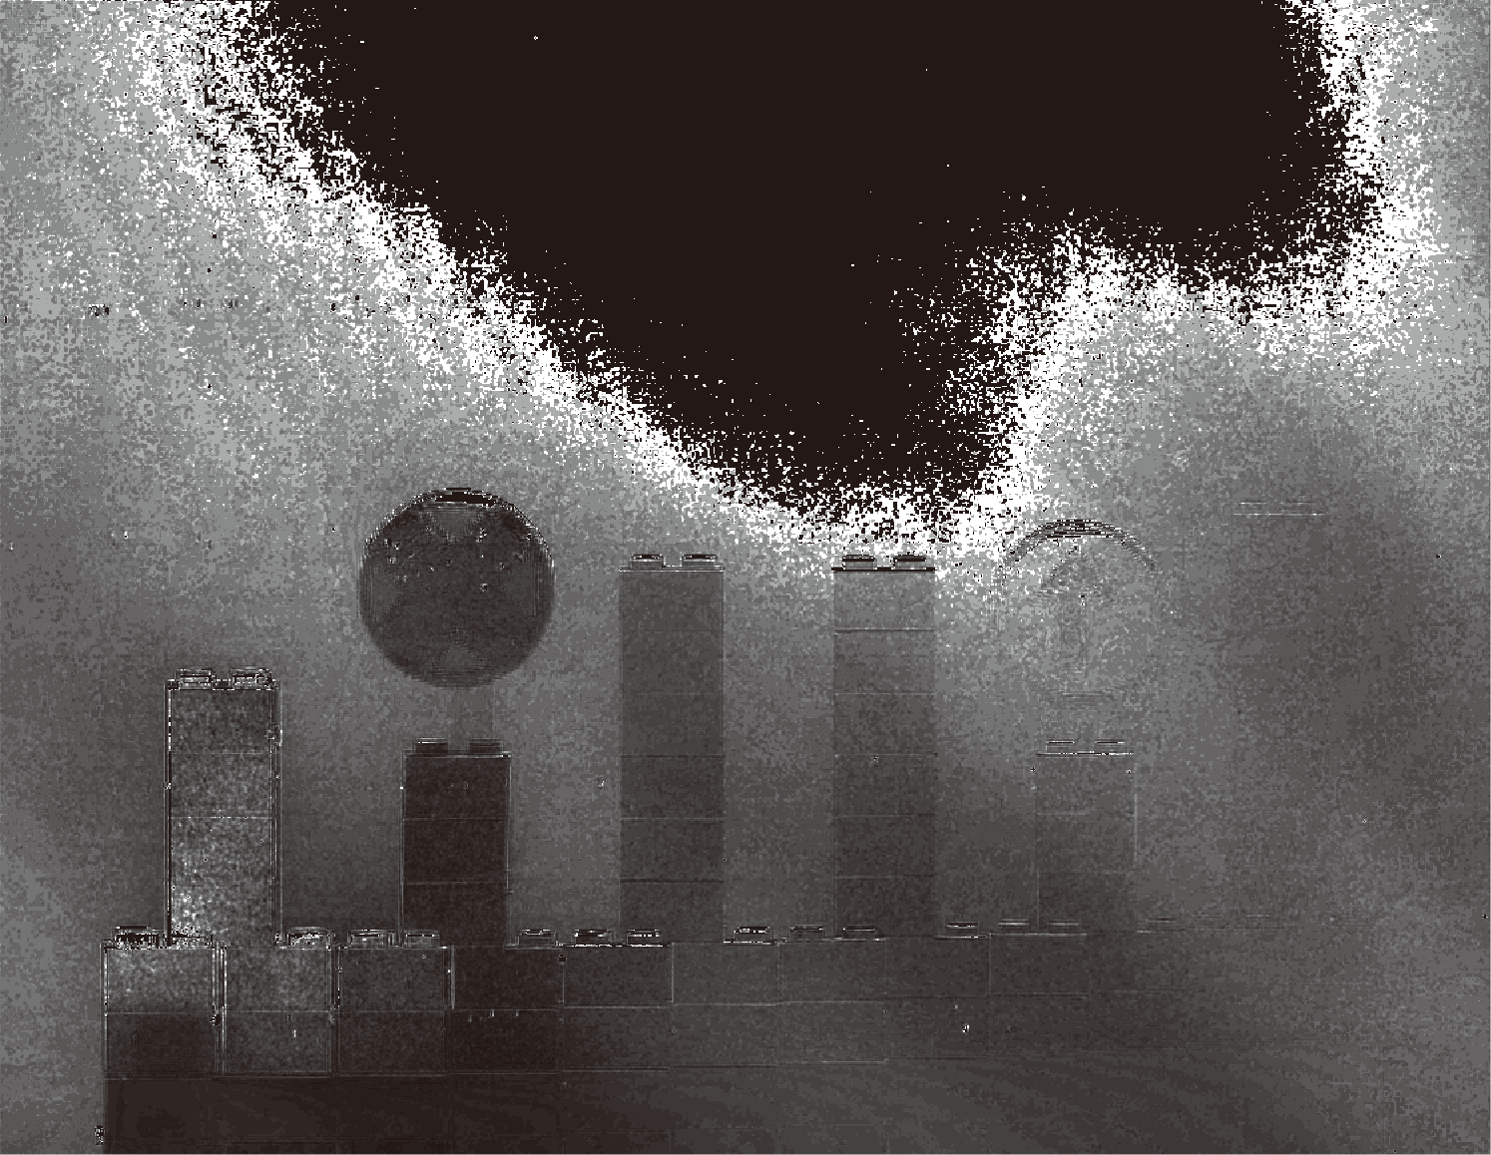
Output image
Introduction(3)
Proposed method(7)
Experiment(5/6)
Discussion(2)
Output
Object light R
Output
Depth Z

Slide 17
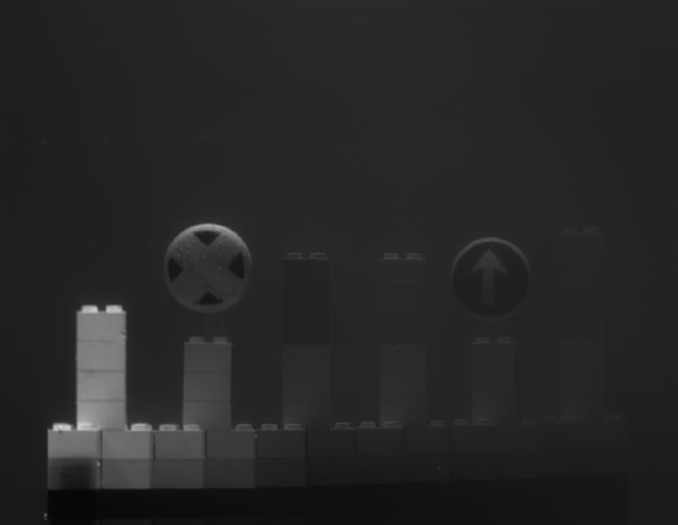
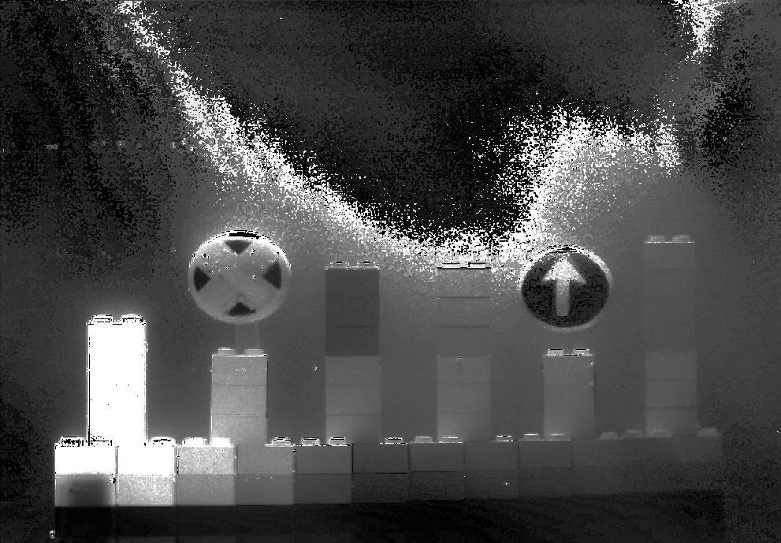
Image enhancement result
Introduction(3)
Proposed method(7)
Experiment(6/6)
Discussion(2)
Input attenuated image
Output ameliorated image

Slide 18
Discussion
Introduction(3)
Proposed method(7)
Experiment(6)
Discussion(1/2)
Sky area not concerned
Image enhanced at
not only reference objects
but also other objects
Close objects fail
→Particle distribution isn’t uniform
→Particle size isn’t same
→Water tank size is finite
→Specular reflection of reference object
→Dark diffuse reflection
→Illumination isn’t uniform
→Close distance from illumination
→Polarization of water surface
→Affected by incident angle

Slide 19
Future work
Introduction(3)
Proposed method(7)
Experiment(6)
Discussion(2/2)
Color relatime polarization camera
Set camera on vehicles
Traffic sign recognition
On-line parameter updation
High precision using 3 or more traffic signs
Creating traffic sign database
Compute distance from traffic sign size
Intrinsic camera calibration

Slide 20
Daisuke Miyazaki 2013
Creative Commons Attribution 4.0
International License.
http://www.cg.info.hiroshima-cu.ac.jp/~miyazaki/
Daisuke Miyazaki, Daisuke Akiyama, Masashi Baba, Ryo Furukawa, Shinsaku Hiura, Naoki Asada, “Polarization-based dehazing using two reference objects,” CPCV, 2013.

