Slide 1
Multi-band photometric stereo using random sampling of channels and pixels
Daisuke Miyazaki
Koumei Hamaen
Hiroshima City University

Slide 2

Photometric stereo
Surface normal estimation
$$I=an∙l$$
3 unknowns
3 grayscale images

Slide 3
Color photometric stereo
RGB lights
One shot
1 color image
Measurable: Dynamically deforming object

Slide 4
Multispectral photometric stereo
Our approach
1 multispectral image
Robust to shadow

Slide 5
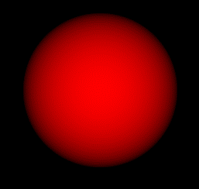

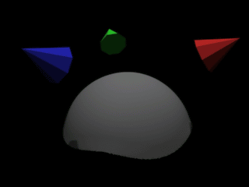
Ambiguity of multispectral PS
Intensity
Albedo
Normal
Light
1
2
1
60°
cos60°
2
1
1
0°
1
cos0°
Solvable if the object is white (uniform albedo)

Slide 6
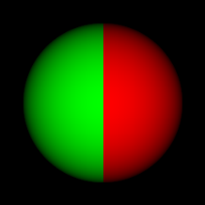





7 equations, 9 unknowns
Intensity
Albedo
Normal
Light
$$I_{0}=A_{0}\max{(n∙l_{0},0)}$$
$I$:Pixel brightness
$$I_{1}=A_{1}\max{(n∙l_{1},0)}$$
$A$:Diffuse albedo
$n$:Surface normal vector
$$I_{6}=A_{6}\max{(n∙l_{6},0)}$$
$l$:Light direction vector
Equations 7
Unknowns 9: A₀,A₁,...,A₆,n_{x},n_{y}
Unsolvable

Slide 7
Our approach
Fyffe et al. [8]
Region segmentation
Anderson et al. [1]
Shape from other sensors
Proposed method
Random sampling
Kim et al. [14]
Optical flow
Miyazaki et al. [17]
Median filter
Guo et al. [10]
Achromatic objects

Slide 8
1 channel, 1 pixel
If 1 channel and 1 pixel is chosen
Input
Known
Intensity
Albedo
Normal
Light
1 unknown
2 unknown
1 equation, 3 unknowns -> Unsolvable
Notes:
これが画像の輝度の話です。
1チャンネル1画素選択した場合です。
式は、画素の輝度はアルベド×法線×光源であらわされます
ここで、入力は画素の輝度、光源は既知、未知数はアルベド1個、法線の未知数2個に対して
式が１つなので解くことができません

Slide 9
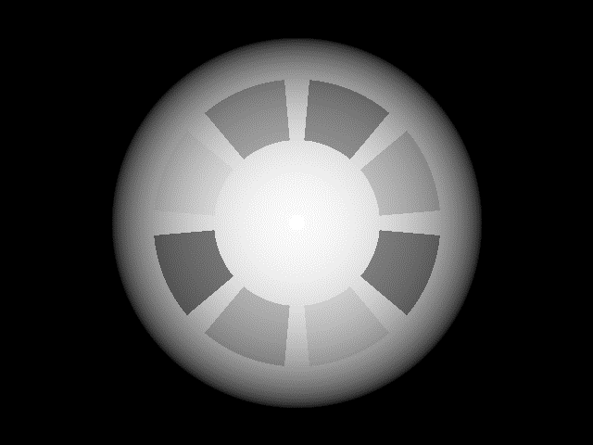
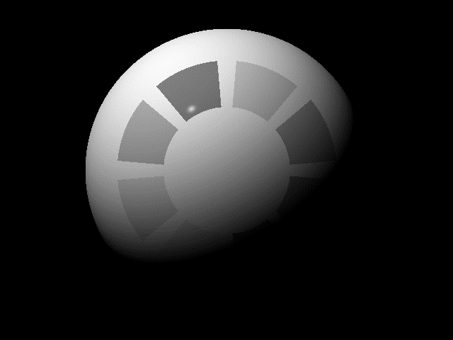
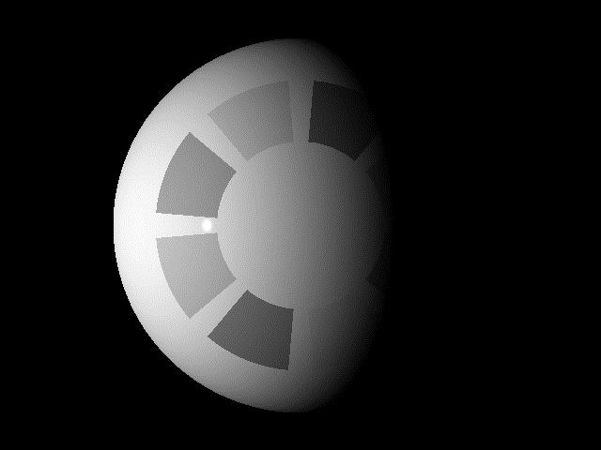
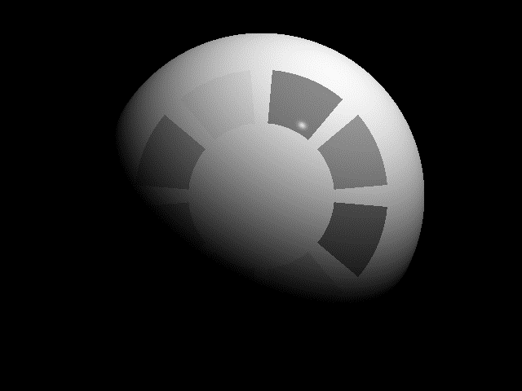
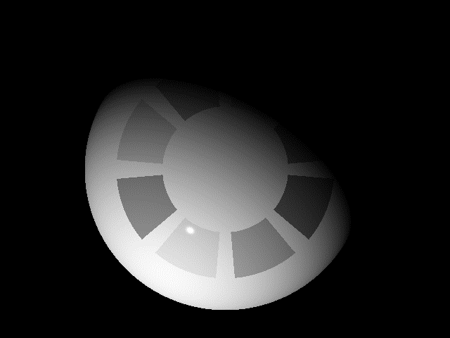
4 channels, 8 pixels
Assuming same albedo among 8 pixels
Equations: 4 x 8 = 32
Albedo: 4
Normal: 2 x 8 = 16
32 equations, 20 unknowns
Solvable
Surface normal is determined
Notes:
選んだ4チャンネルと8画素選択から法線推定をしました
そこから、

Slide 10
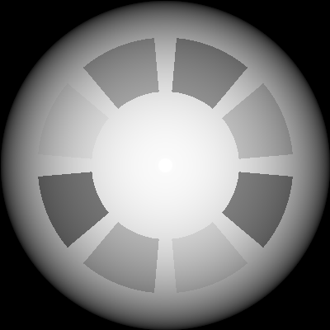
Choose 8 pixels randomly
We have to choose same albedo pixels
Near pixels have high possibility: Same albedo
Not always true
Randomly choose
Interest pixel
3×3
7×7
13×13
21×21
29×29
41×41
55×55

Slide 11
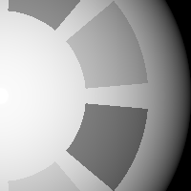
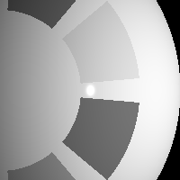




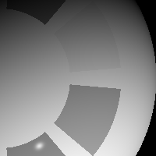
Choose 4 channels randomly
Some channel includes shadows and speculars
Brighter channels have high possibility: Non shadow
Not always true
Randomly choose
Specular reflection
Shadow
Diffuse reflection
Notes:
チャンネルによるノイズを回避するために
輝度を用いてランダムにチャンネルを選択するようにした
輝度が高いほど選ばれやすくした

Slide 12
Calculated surface normal
Interest pixel
Same albedo
Chosen pixel
Different albedo
True normal
Calculated normal
(constant albedo)
Calculated normal
(variable albedo)
Notes:
これが推定される法線の一例です
しんのほうせん
チャンネル内のアルベドが一定であれば正しく推定できる
しかし、チャンネル内のアルベドが一定では無ければ正しく推定できない

Slide 13
Surface normal candidate
Choose another set of 4 channels, 8 pixels
Candidates of surface normal
64 candidates of surface normal
Outlier removal of candidate
Final surface normal
Correct
Outlier
Notes:
選択した画素がアルベドが同一であれば解くことができます
ランダムに選択して条件がよければ解ける
ここでは、注目画素１つに対して2画素選択して3チャンネル選択した例です。

Slide 14
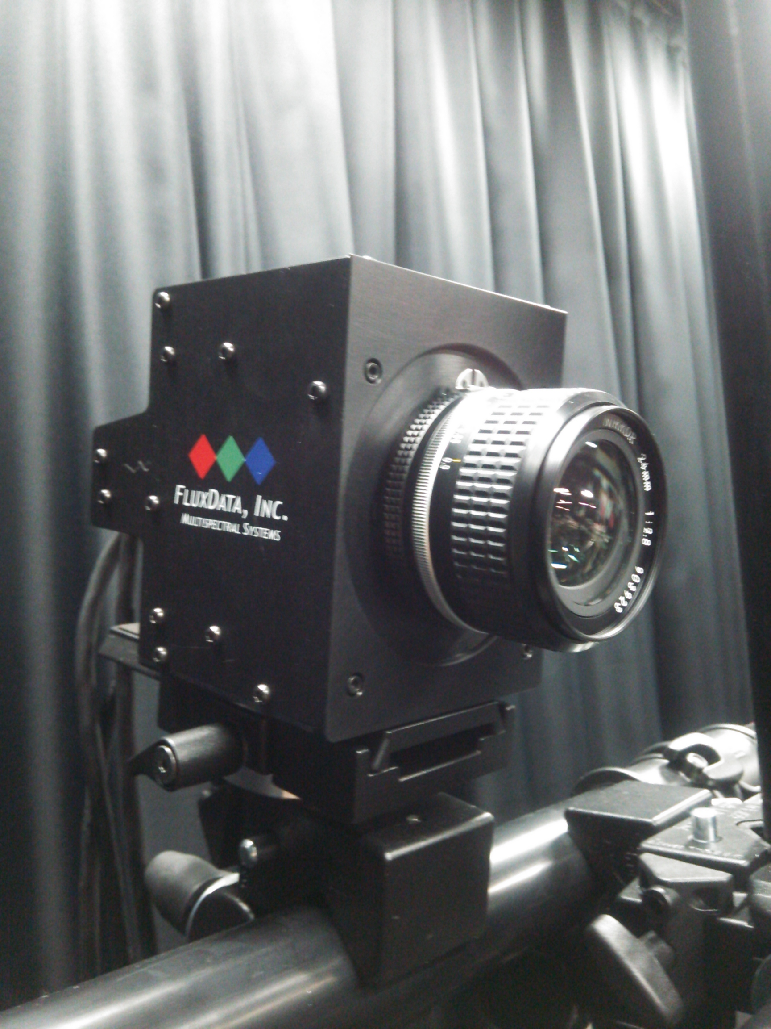
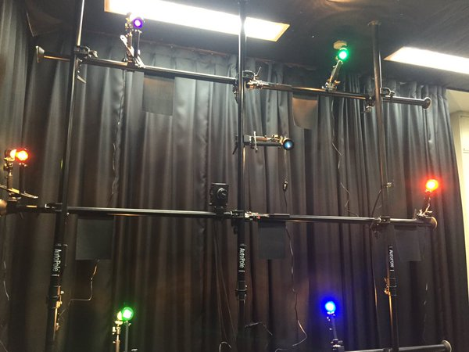
1 multispectral camera
7 multispectral light
Light 6: 430 nm
Light 4: 520 nm
Light 0: 750 nm
Light 1: 632 nm
Light 2: 610 nm
Multiband camera
Light 3: 550 nm
Light 5: 470 nm

Slide 15







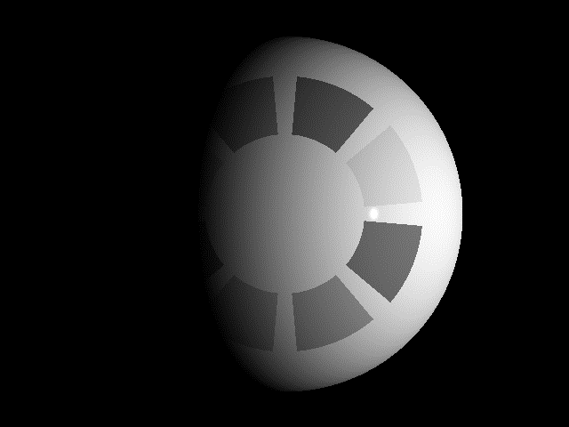
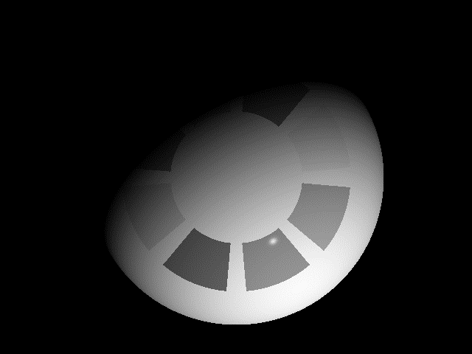

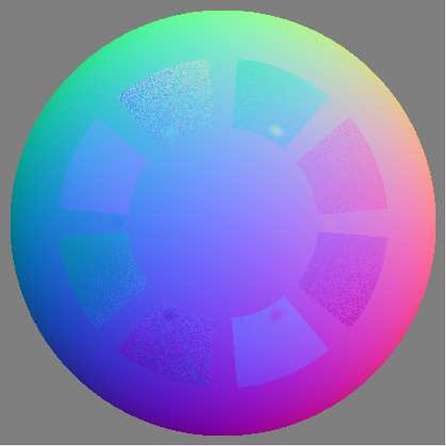
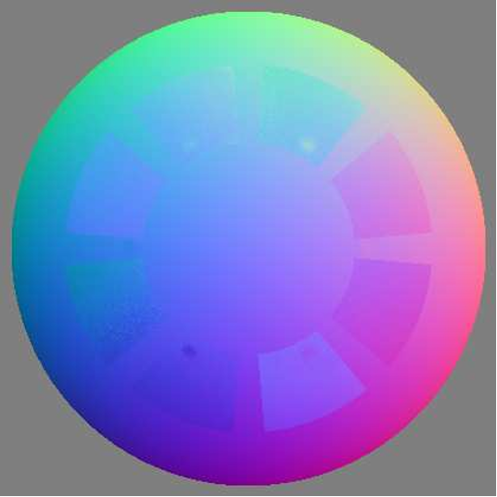

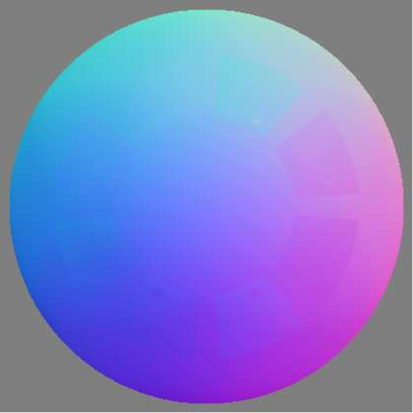
Simulation result
Albedo
Input
Ch. 0
Ch. 1
Ch. 2
Ch. 3
Ch. 4
Ch. 5
Ch. 6
Ground truth
3 channel, 4 pixels
4 channel, 8 pixels
4 channel, 16 pixels
7 channel, 16 pixels

Slide 16
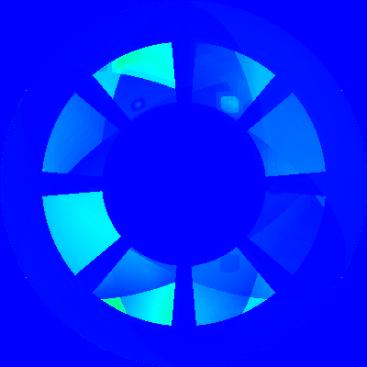
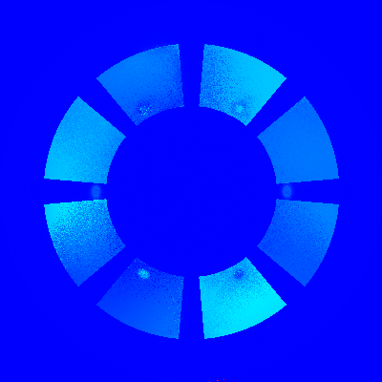
Evaluation
1.57
Error
[rad]
0
Photometric stereo
Proposed method
(Color photometric stereo
with white object)
(4 channels, 8 pixels)

Slide 17
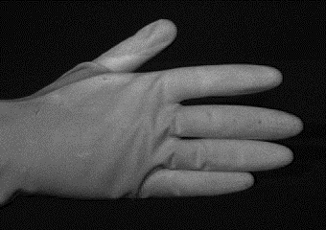
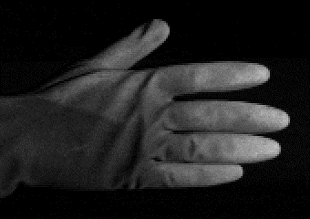
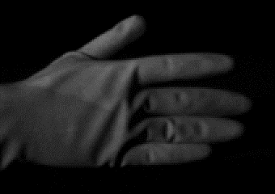
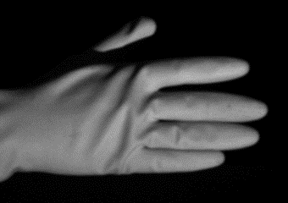
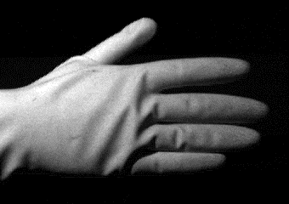
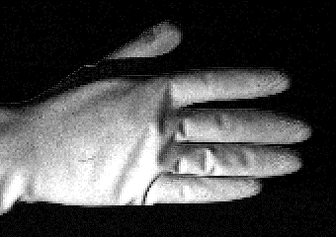
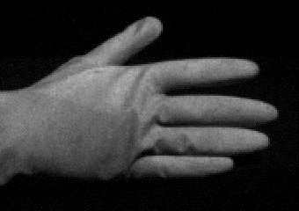
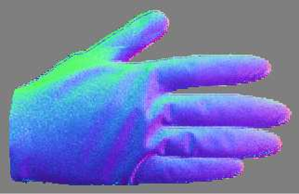
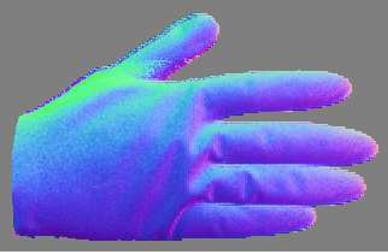
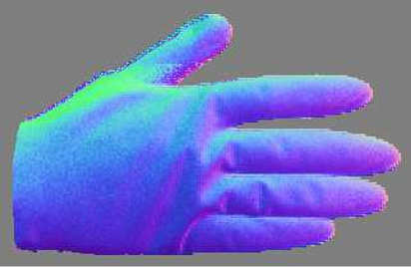
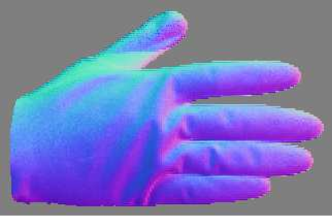
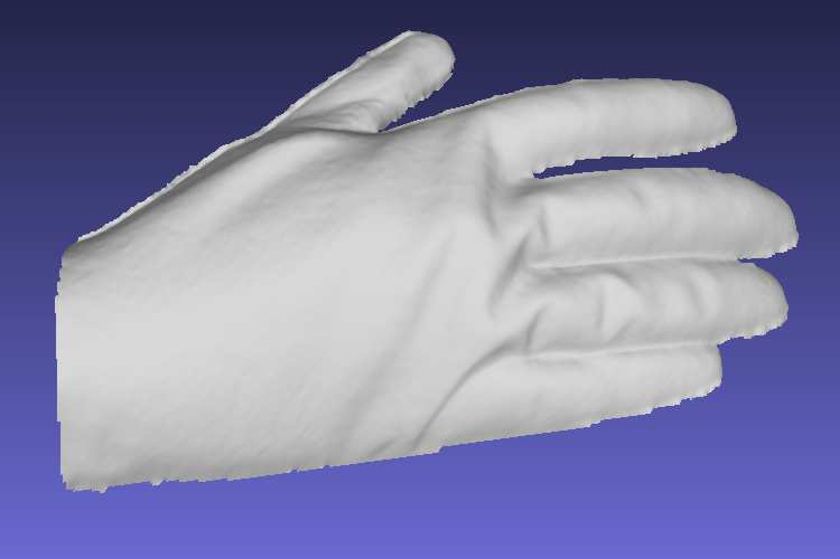
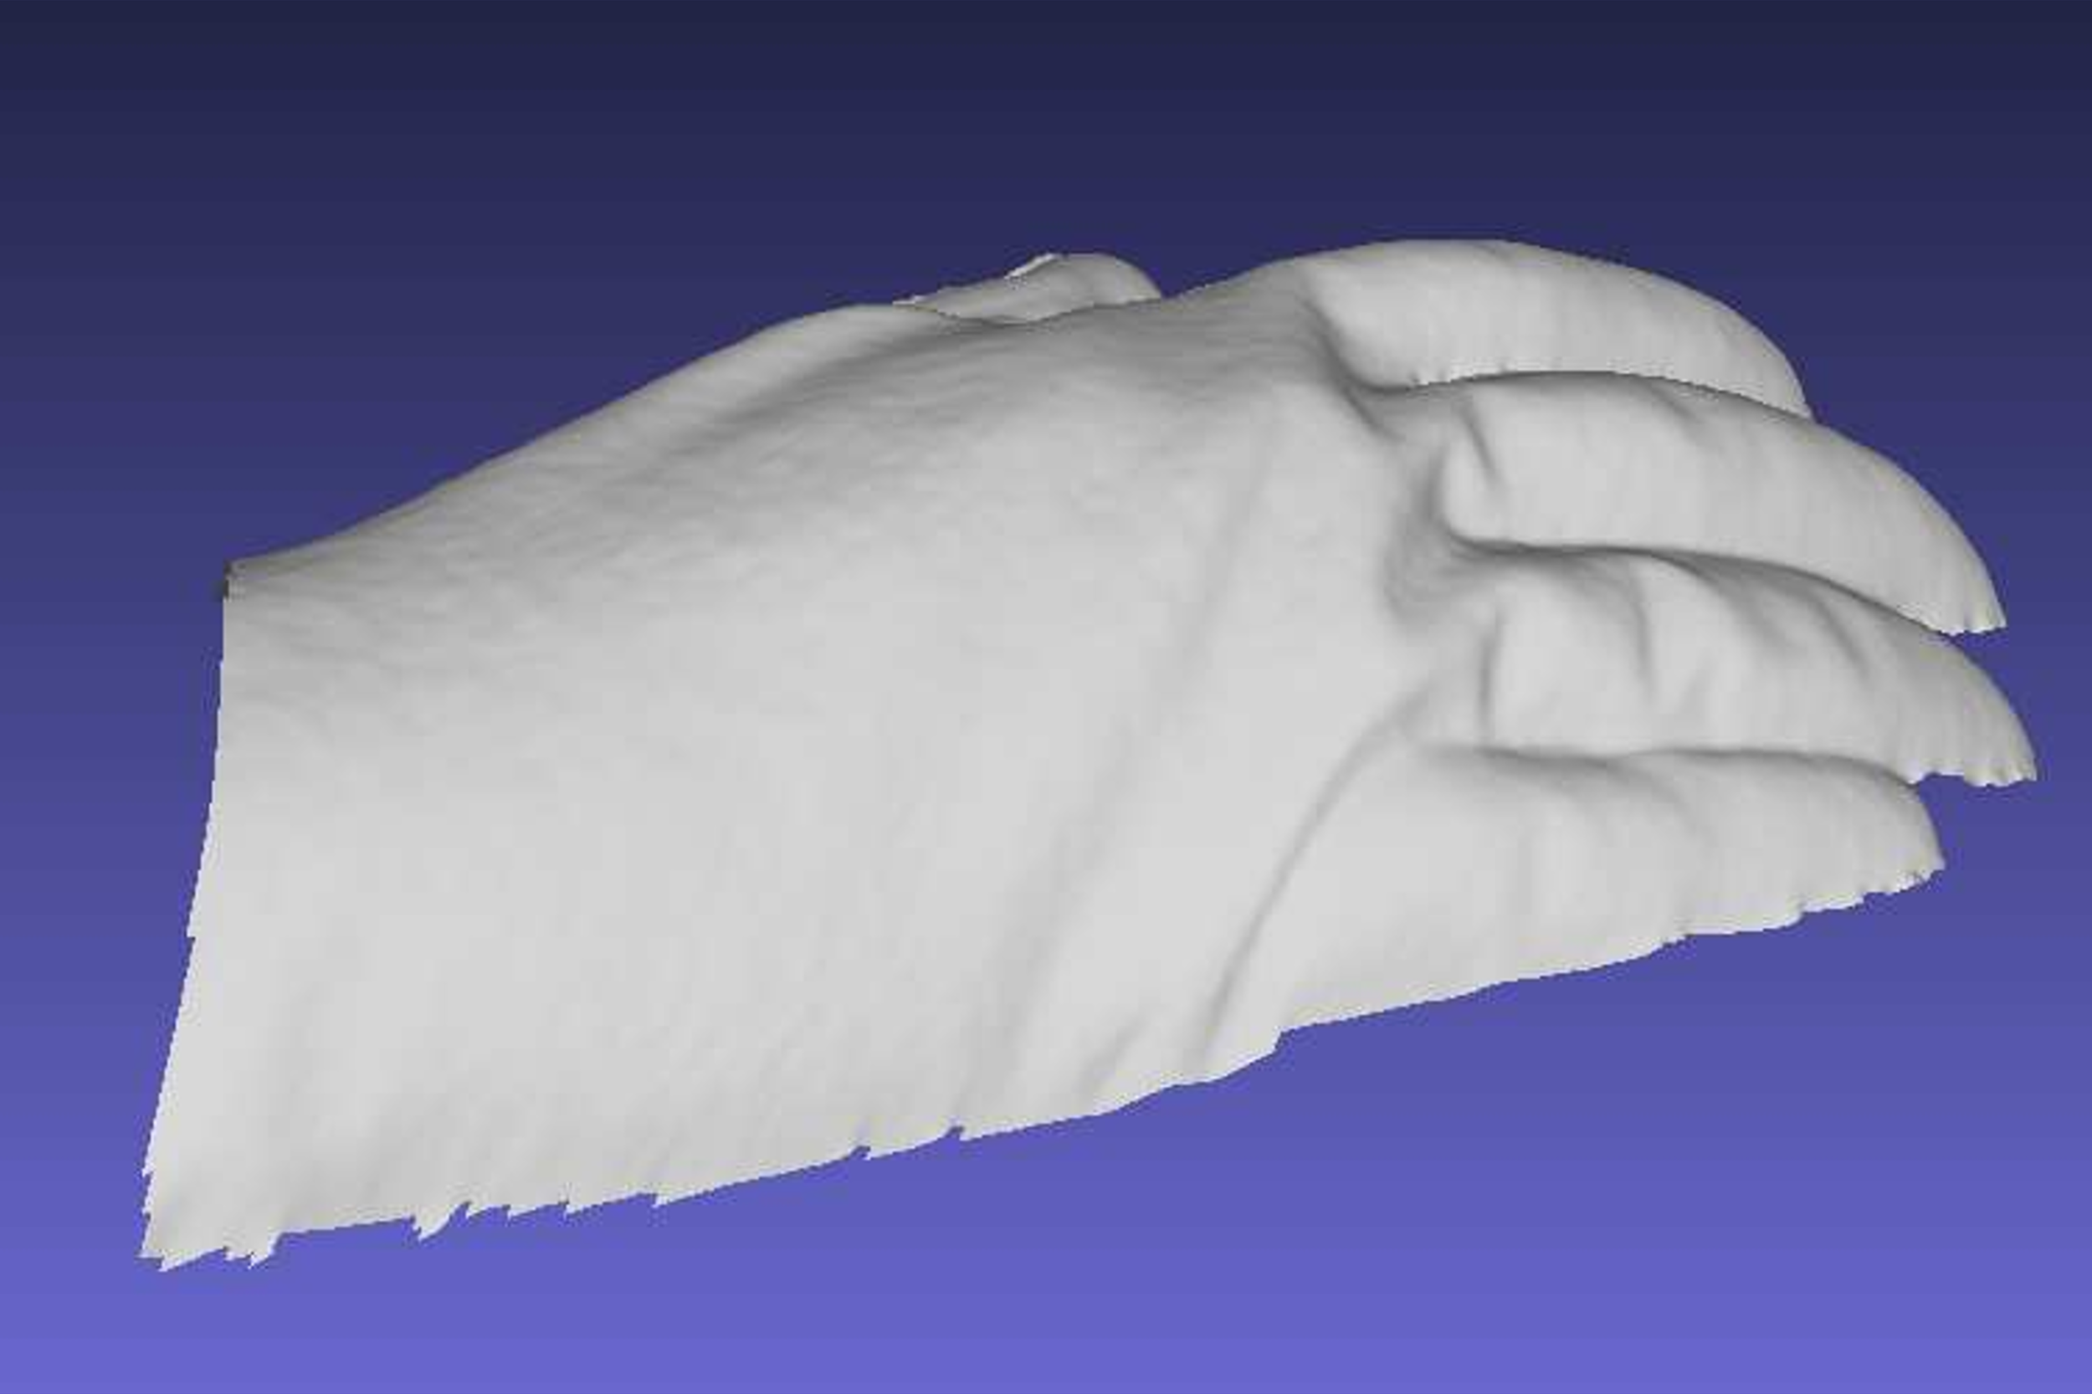
Glove result
Ch. 0
Ch. 1
Ch. 2
Ch. 3
Ch. 4
Ch. 5
Ch. 6
3 channel, 4 pixels
4 channel, 8 pixels
4 channel, 16 pixels
7 channel, 16 pixels

Slide 18
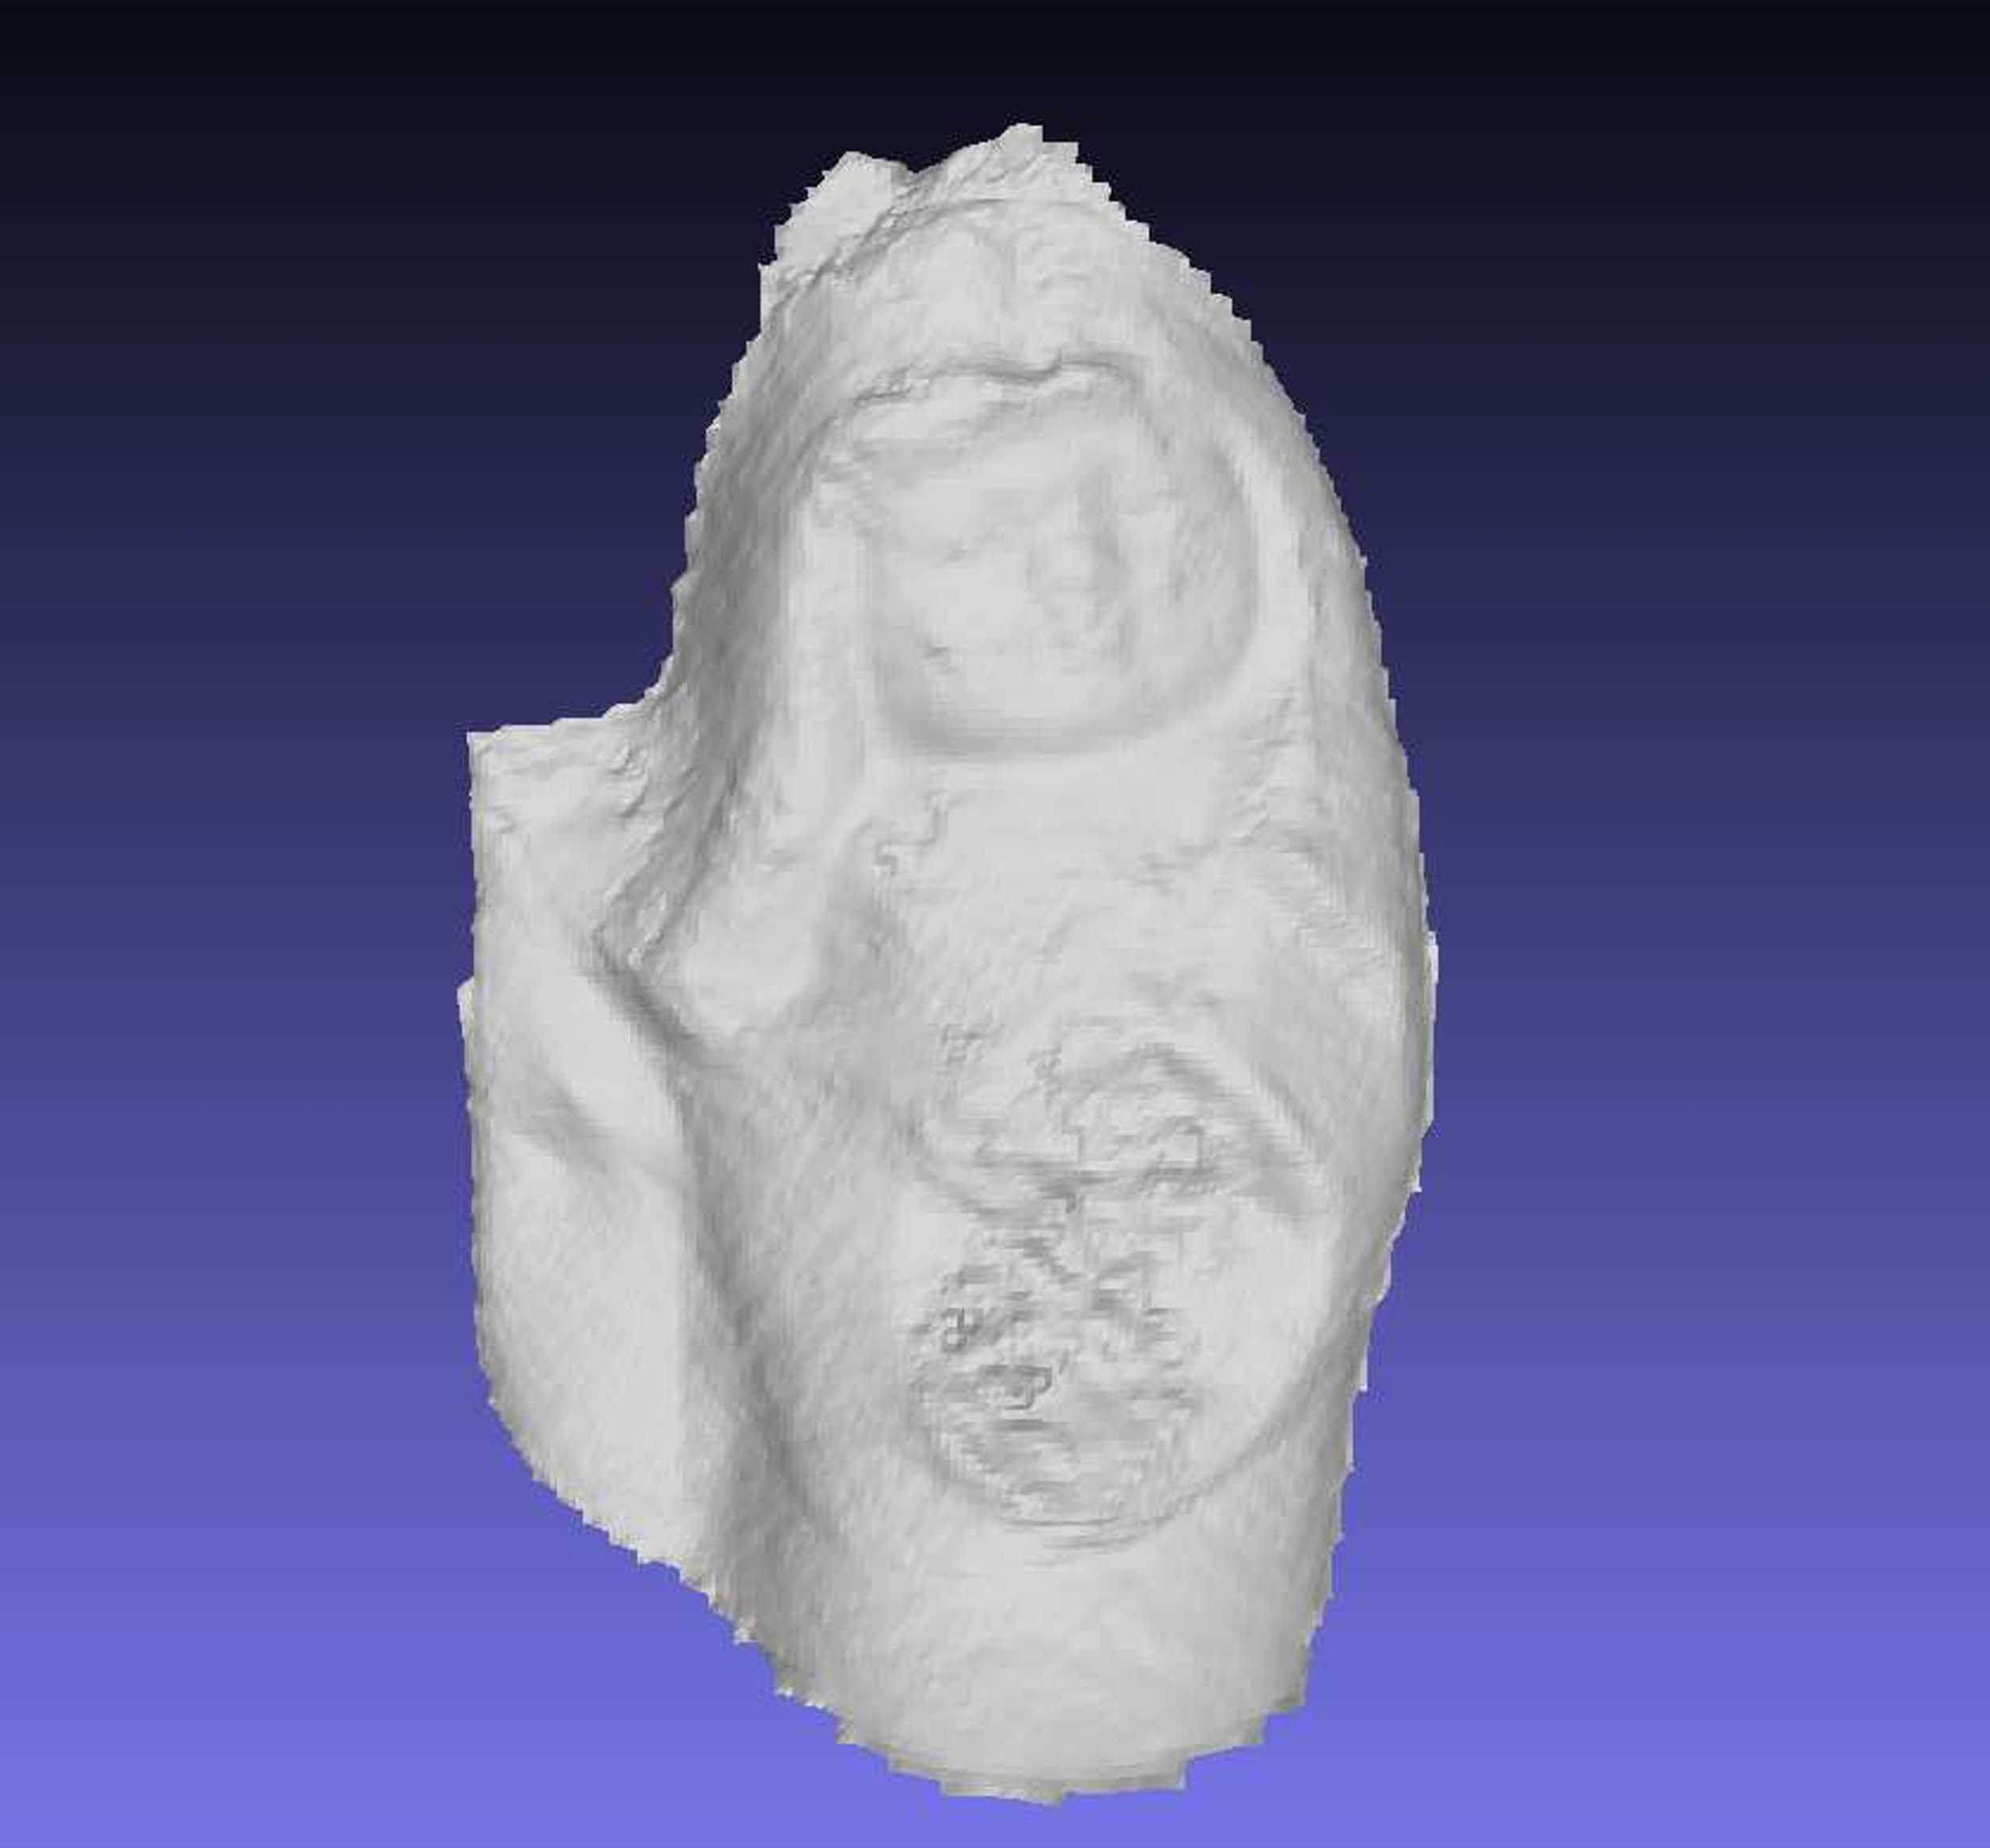
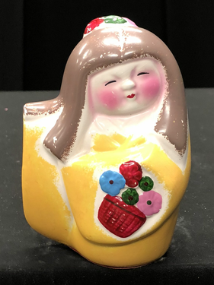
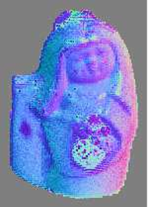
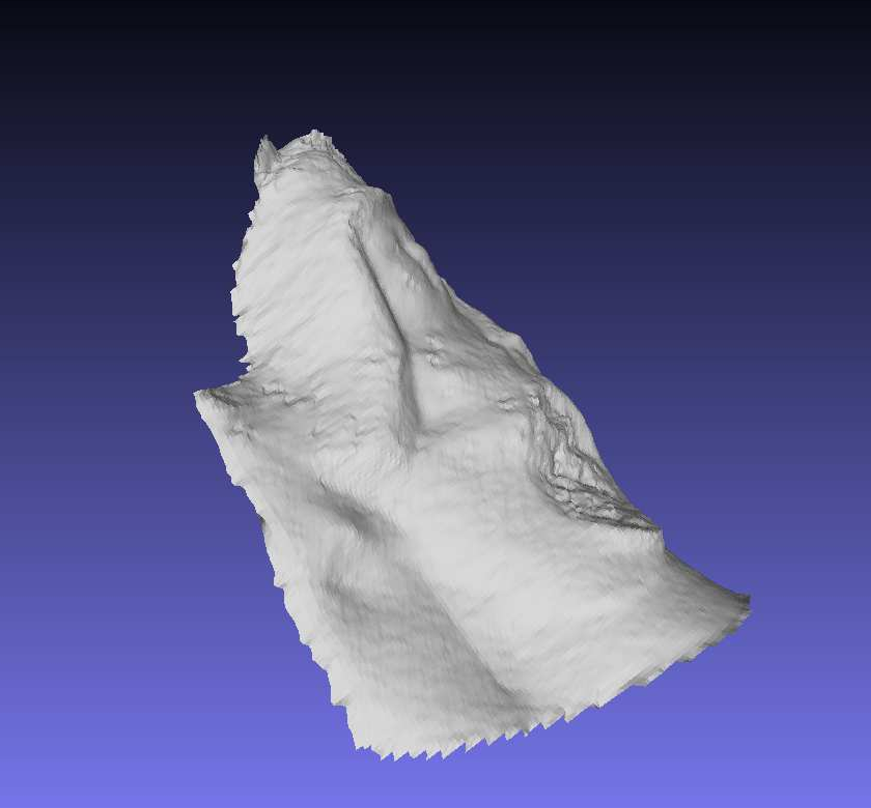
Doll result

Slide 19
Conclusion
Conclusion
Multispectral photometric stereo
Non-white object
Random sampling approach
Future work
More elegant sampling than random sampling

Slide 20
Daisuke Miyazaki 2022
Creative Commons Attribution 4.0 International License.
http://www.info.hiroshima-cu.ac.jp/~miyazaki/
Daisuke Miyazaki, Koumei Hamaen, "Multi-band photometric stereo using random sampling of channels and pixels," IW-FCV2022, 2022.02

