Slide 1
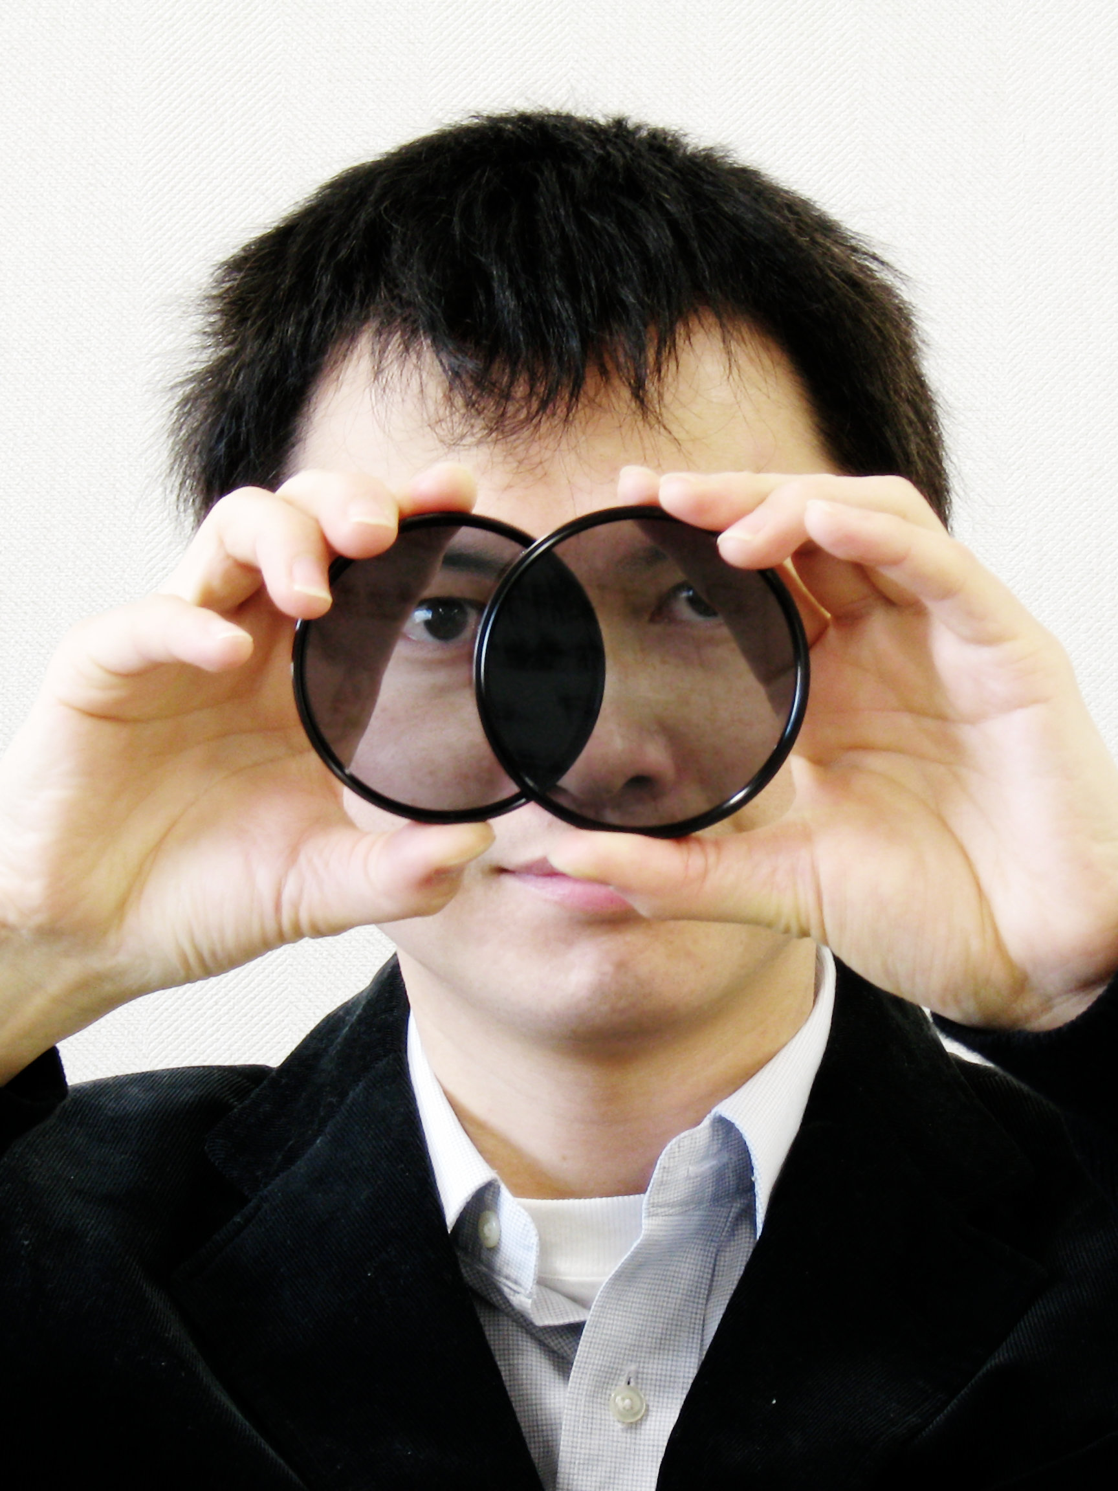
Shape from Polarization
宮崎大輔

Slide 2
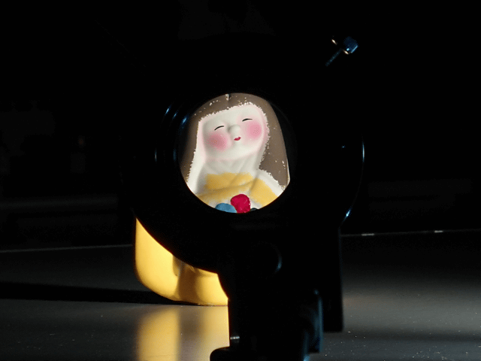

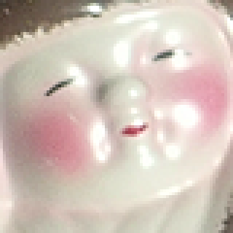
Polarization
Notes:
Here is the separated result.

Slide 3
Wave oscillation
Light is electromagnetic wave
Oscillates in one direction
Polarization
Light
Polarizer
Unpolarized
Polarized

Slide 4

Polarization parameters
$$I=\frac{I_{max}+I_{min}}{2}+\frac{I_{max}−I_{min}}{2}\cos\left(2ν−2ψ\right)$$
180deg cycle
180deg cycle
255
I_{max}
Pixel brightness
I_{min}
0
Phase angle
ψ
180deg
Phase angle
ψ
360deg

Slide 5
Parallel/Perpendicular component
Normal
Light
Incidence
angle
Reflection
angle
Unpolarized
Partially polarized
Incident
light
θ₁
θ₁
Reflected
light
s
Air
Object
p
Transmitted
light
θ₂
Transmission
angle
Partially polarized
p component: parallel to reflection plane
s component: perpendicular to reflection plane

Slide 6



Fresnel equation
1
$$R_{p}=\frac{\tan^{2}\left(θ_{1}−θ_{2}\right)}{\tan^{2}\left(θ_{1}+θ_{2}\right)}$$
$$R_{s}=\frac{\sin^{2}\left(θ_{1}−θ_{2}\right)}{\sin^{2}\left(θ_{1}+θ_{2}\right)}$$
Reflectivity
Snell's law
$$\sin{θ_{1}}=n\sin{θ_{2}}$$
0
Reflection angle
θ₁
90deg
Surface normal orientation: polarizer angle of Imin (p component)

Slide 7
Polarization and surface normal
Azimuth angle
Phase angle
Imin angle = surface normal candidates
Surface normal candidates
Polarization
camera
Reflection
plane
Partially
polarized
Unpolarized

Slide 8
Two viewpoints
Azimuth angle 2
Azimuth angle 1
Surface normal
Camera 2
Camera 1
Reflection
plane 1
Reflection
plane 2
Object surface

Slide 9

(SVD) Singular Value Decomposition
singular vector of smallest singular value
$$\left(\begin{matrix}a_{1}^{⊤}R_{1} \\ a_{2}^{⊤}R_{2} \\ ⋮ \\ a_{K}^{⊤}R_{K}\end{matrix}\right)\left(\begin{matrix}n_{x} \\ n_{y} \\ n_{z}\end{matrix}\right)=\left(\begin{matrix}0 \\ 0 \\ ⋮ \\ 0\end{matrix}\right)$$

Slide 10
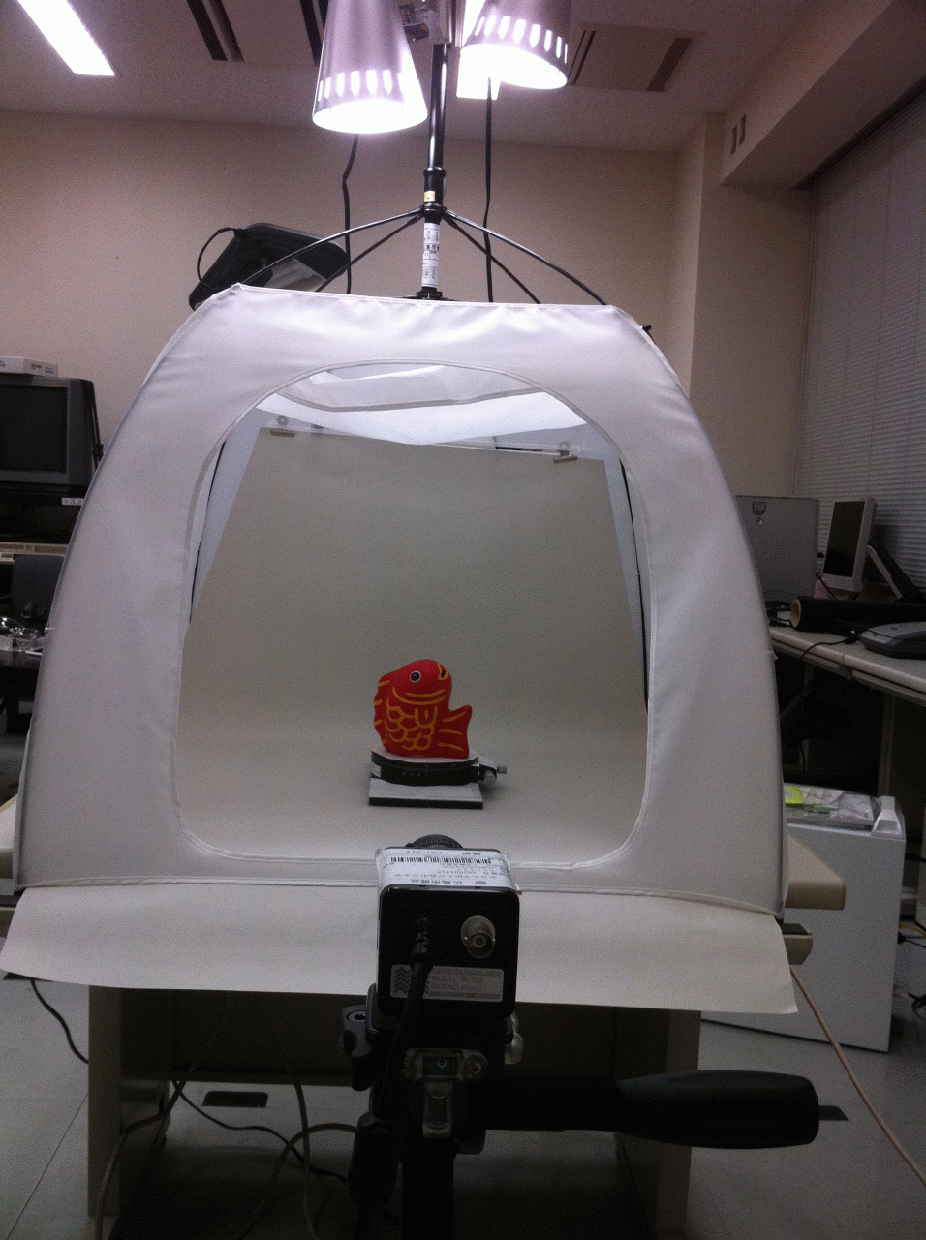
Experimental setup
Uniform light
Lighting dome
Target object
Rotating table
Different view
Polarization camera

Slide 11
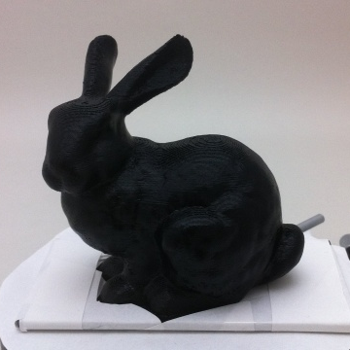
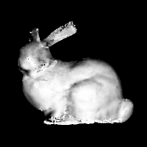
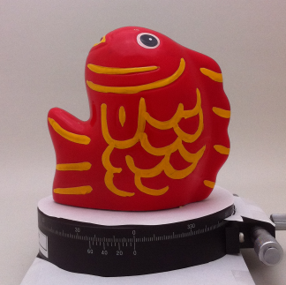
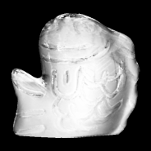
Surface normal estimation

Slide 12
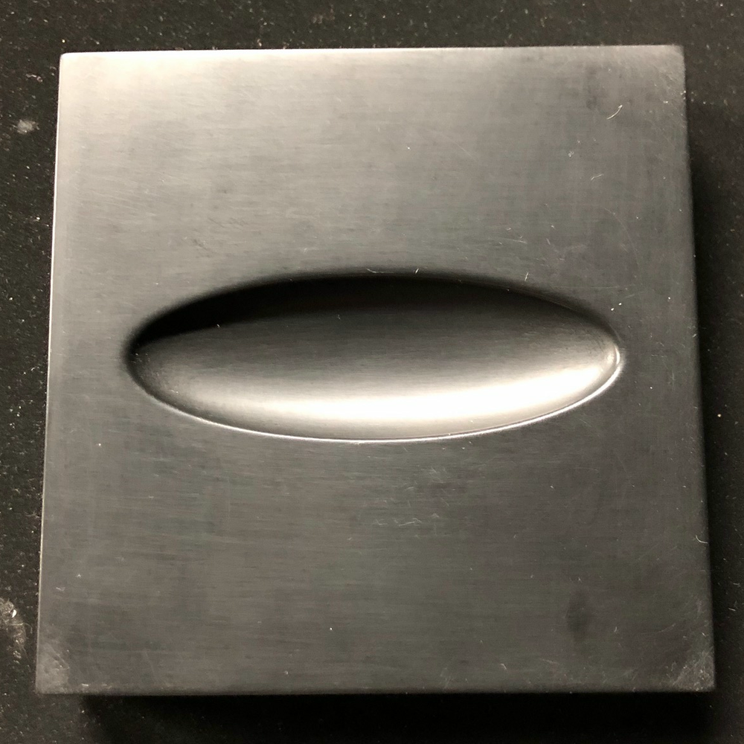
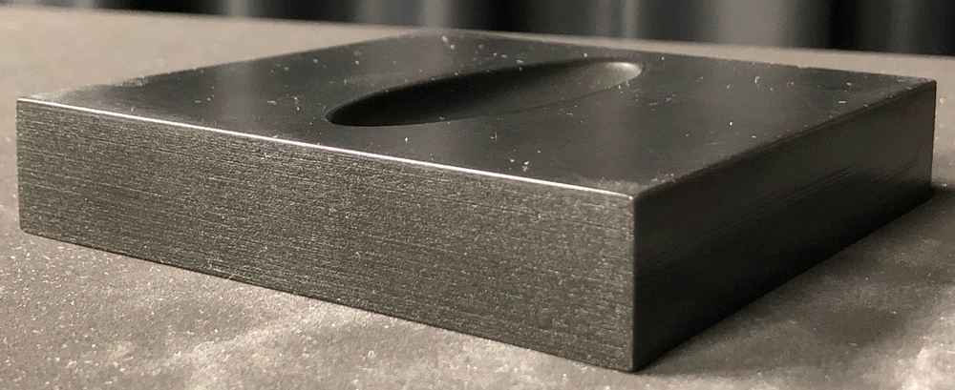
Concave shape estimation

Slide 13
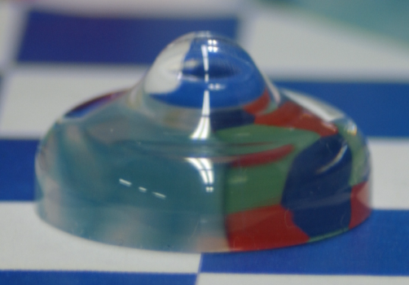
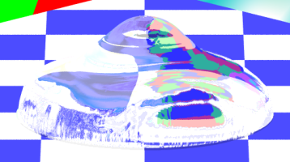
Transparent object
Shape-from-polarization of transparent object
Polarization
Target object
Estimated shape

Slide 14
Polarization raytracing
Raytracing
Polarization state
Calculating Stokes vector

Slide 15
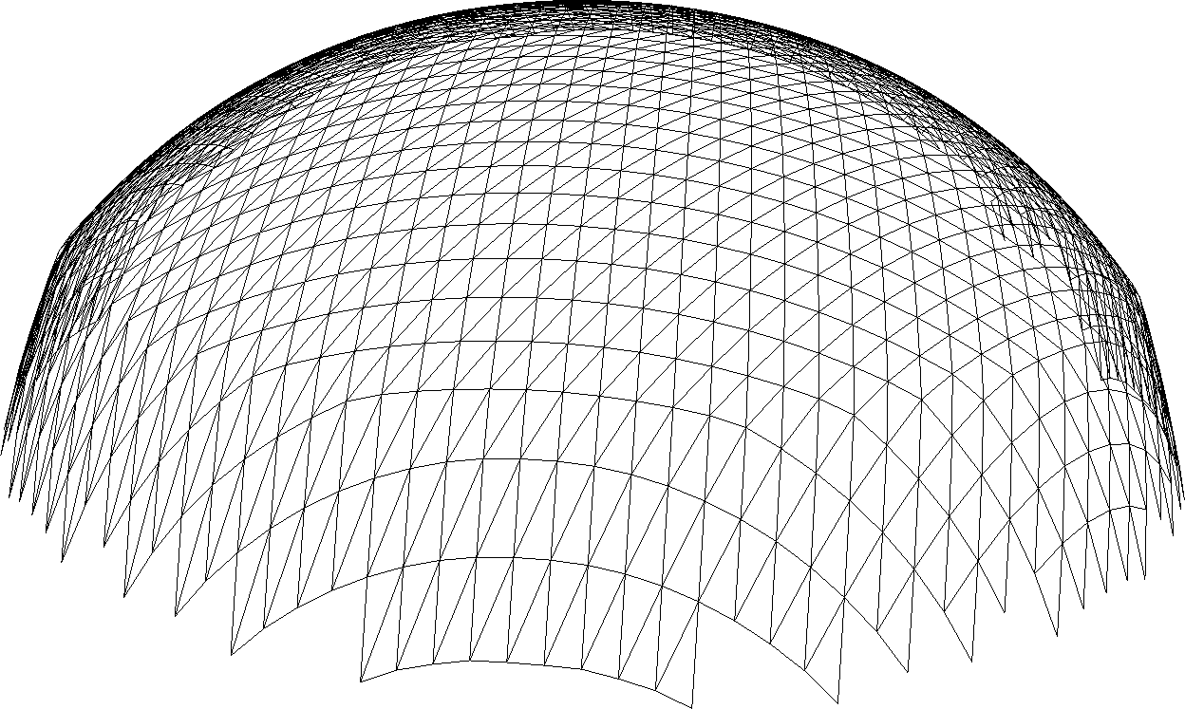
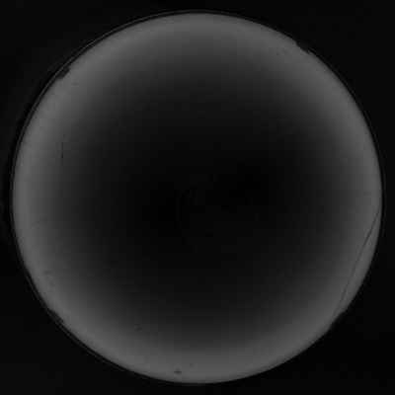

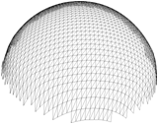
Optimization
Initial shape
Optimization
Update shape
2
min
Input Stokes vector
(Measured data)
Calculated Stokes vector
(Polarization raytracing)
Estimated shape

Slide 16
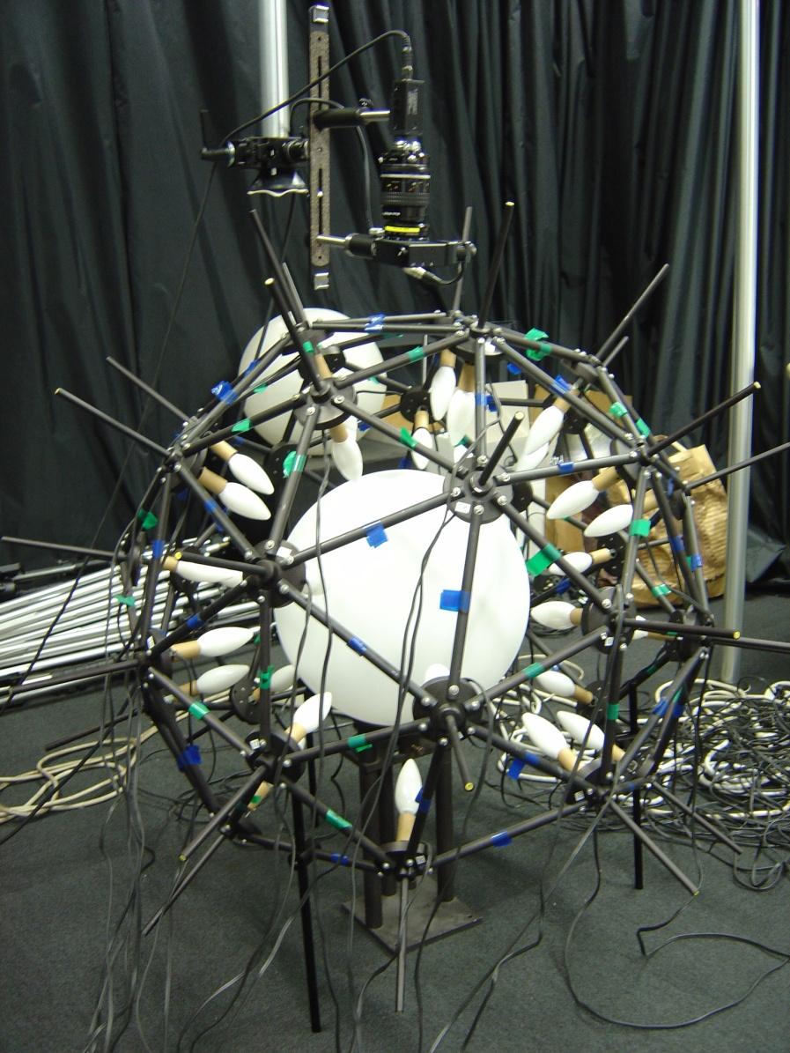
Experimental setup
Monochrome camera
Camera adapter
Computer
IR/UV cut filter
Electric polarizer
Geodesic dome
Plastic sphere
40W lamp
Polarizer controller
Transparent object

Slide 17
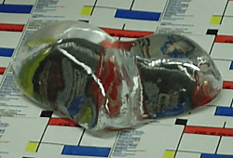
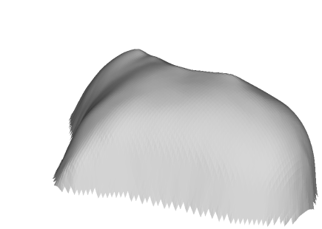
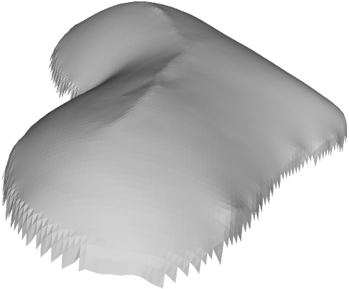
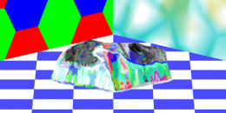
Shape estimation
Glass (IOR 1.5)
Estimated shape
Initial shape

Slide 18
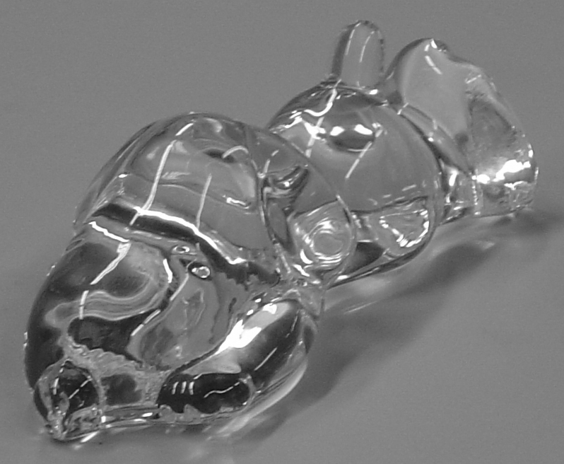
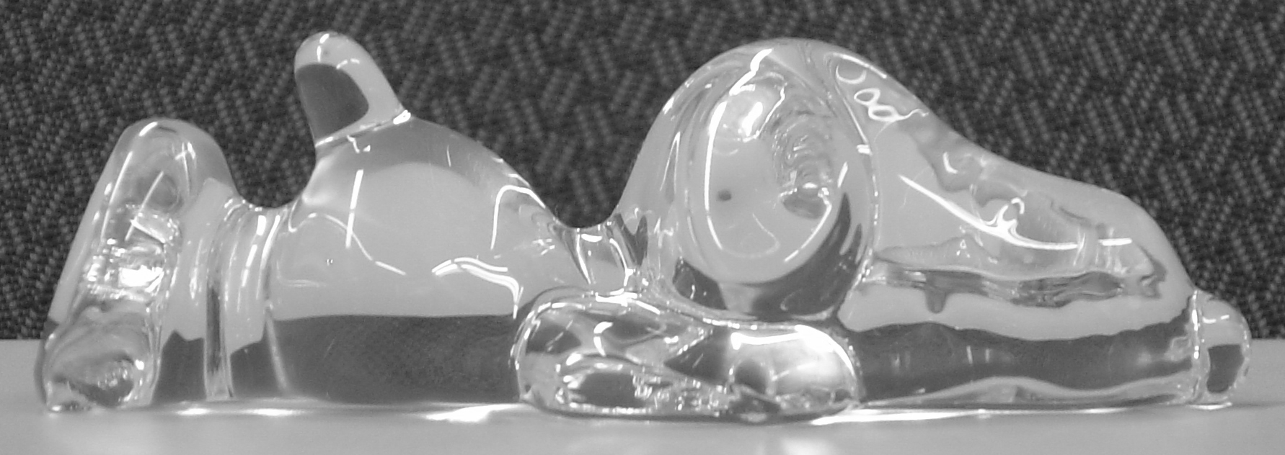
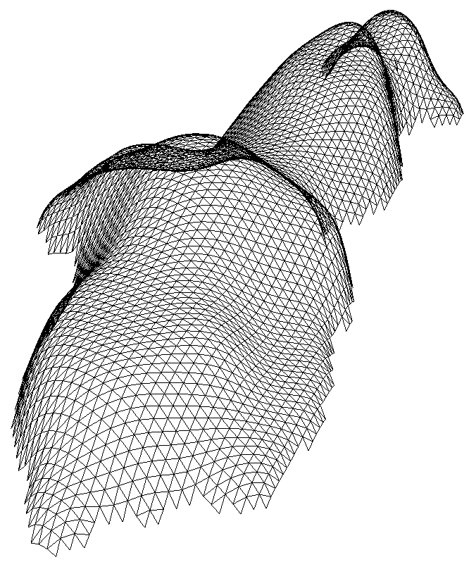
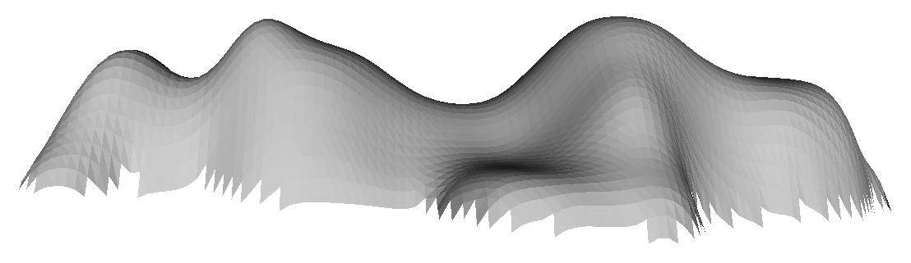
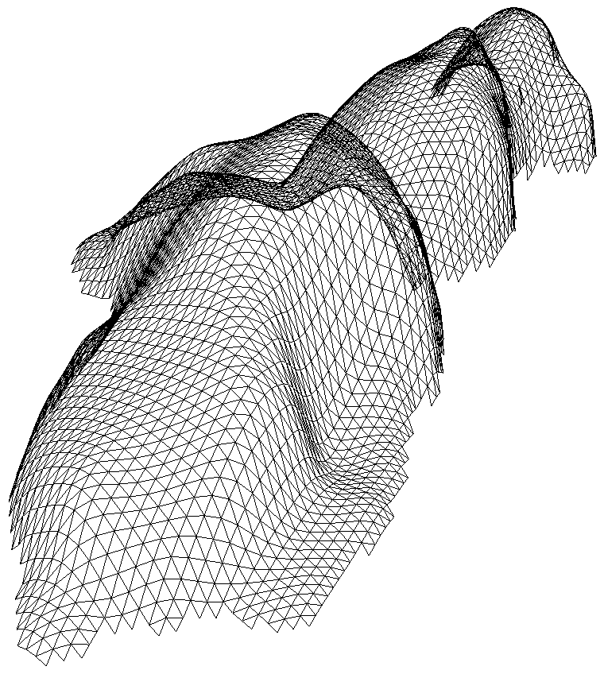
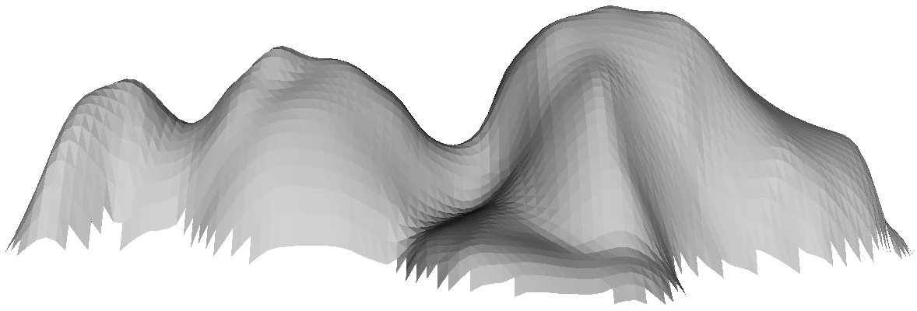
Shape estimation
Initial shape
Estimated shape

Slide 19
Conclusion
Today's talk
  Shape-from-polarization of black object
  Shape-from-polarization of transparent object
Other shape-from-polarization (survey)
  K. Ikeuchi, Y. Matsushita, R. Sagawa, H. Kawasaki, Y. Mukaigawa, R. Furukawa, D. Miyazaki, "Active Lighting and Its Application for Computer Vision," Springer, 2020.

Slide 20
Daisuke Miyazaki 2021
Creative Commons Attribution 4.0 International License.
http://www.cg.info.hiroshima-cu.ac.jp/~miyazaki/
Daisuke Miyazaki, "Shape from polarization," ICDIP, 2021.05

