Slide 1
Image Enhancement for Dichromats by Weighting the Color Difference Between Neighboring Pixels
Daisuke Miyazaki
Takuro Namiki
Hiroshima City University

Slide 2
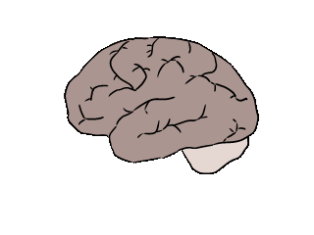
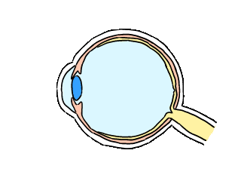
Color perception
Recognition
Red
L cone cells
Green
M cone cells
Light
Brain
Blue
S cone cells
Eye
1
Relative
response
0
400
Wavelength [nm]
700
Notes:
0:24

Slide 3
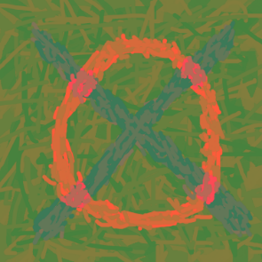

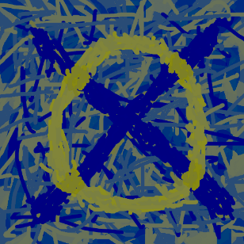
Overview
Trichromats: LMS cells
Dichromat Protanopia: MS cells
Dichromat Deuteranopia: LS cells
e.g. 5% Japanese male
0.2% Japanese female
Input
Dichromat
Cannot distinguish some colors
Image enhancement for dichromats
Improved
Notes:
0:36

Slide 4
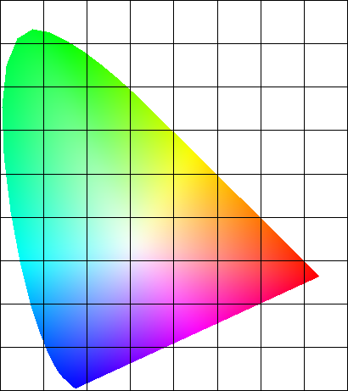
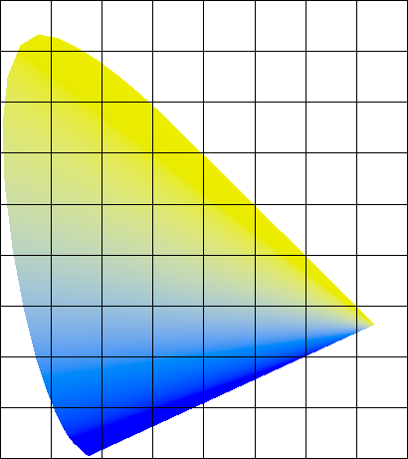
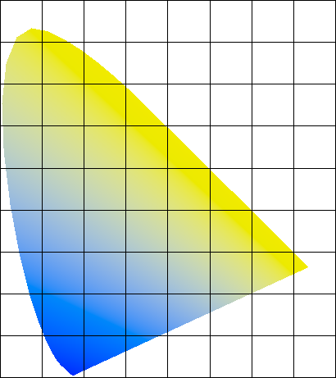
Color confusion lines
140 [deg]
140 [deg]
y
y
y
0.6
0.6
0.6
Hue angle α
Hue angle β
Hue angle β
170 [deg]
155 [deg]
0.4
White point
(0.33, 0.33)
0.4
0.4
White point
(0.747, 0.278)
0.2
0.2
0.2
White point
(1.000, 0.000)
170 [deg]
0.2
0.4
0.6
x
200 [deg]
0.2
0.4
0.6
x
0.2
0.4
0.6
x
Trichromats
Protanopia
Deuteranopia
Dichromats
LMS cells
MS cells
LS cells
Notes:
0:52

Slide 5
Color difference
3chromats
2chromats
Color improvement
Or, for example,
depending on surrounding pixels and random initial values
3chromats
2chromats
Notes:
0:48

Slide 6
Poisson equation
Color angle difference
Δα(u,v-1)
α(u,v-1)
β(u,v-1)
Δα(u-1,v)
Δα(u+1,v)
Δα(u,v+1)
α(u-1,v)
α(u,v)
α(u+1,v)
β(u-1,v)
β(u,v)
β(u+1,v)
α(u,v+1)
β(u,v+1)
Color difference of input
Color difference of output
Color difference
of trichromats perception
Color difference
of dichromats perception
Notes:
0:41

Slide 7

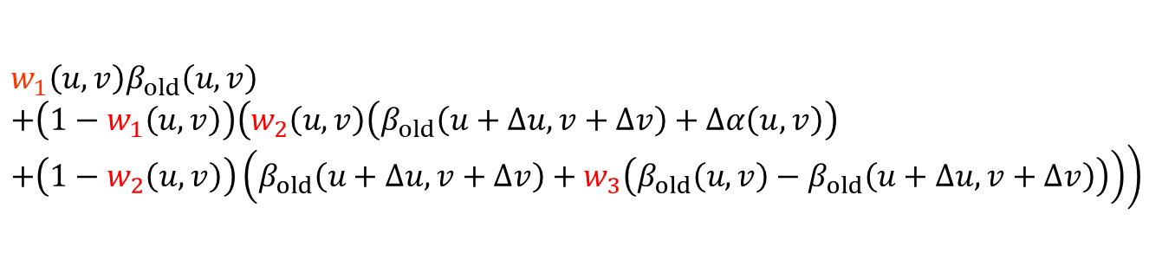



Proposed method
$$β_{old}\left(u,v\right)$$
Random value
Iterate
$$β_{new}\left(u,v\right)$$
Input image
Output image k
Output image k+1
$$w_{1}\left(u,v\right)β_{old}\left(u,v\right)$$
$$+\left(1−w_{1}\left(u,v\right)\right)\left(w_{2}\right.\left(u,v\right)\left(β_{old}\left(u+∆u,v+∆v\right)+∆α\left(u,v\right)\right)$$
$$\left.+\left(1−w_{2}\left(u,v\right)\right)\left(β_{old}\left(u+∆u,v+∆v\right)+w_{3}\left(β_{old}\left(u,v\right)−β_{old}\left(u+∆u,v+∆v\right)\right)\right)\right)$$
$$β_{old}\left(u,v\right)$$
$$β_{new}\left(u,v\right)$$
Post-processing (Histogram equalization, etc.)
(Update rule: Derived from Poisson equation and successive overrelaxation)
Notes:
0:33

Slide 8






Weight 1
100
90
90
dark
90
$$β^{k−1}=β^{k}$$
$$β^{k−1}$$
$$β^{k}$$
10
Iteration process
Color difference
of input image
$$Δα$$
Not affected by dark pixel
$$β^{k}\left(u,v\right)=w_{1}\left(u,v\right)β_{1}^{k}\left(u,v\right)+\left(1−w_{1}\left(u,v\right)\right)β_{2}^{k}\left(u,v\right)$$
Next slide
$$e^{−m_{1}{\left(I\left(u,v\right)\right)}^{2}}$$
$$β^{k−1}\left(u,v\right)$$
Unchanged
Pixel brightness
User-defined parameter
Notes:
1:03

Slide 9


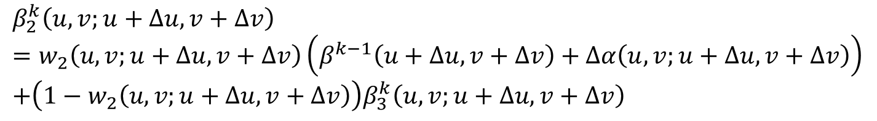
Weight 2
100
90
90
90
100
90
$$β^{k−1}+∆α$$
$$β^{k−1}$$
$$β^{k}$$
10
Iteration process
Color difference
of input image
$$Δα$$
Same color difference as trichromats
$$β_{2}^{k}\left(u,v;u+∆u,v+∆v\right)$$
$$=w_{2}\left(u,v;u+∆u,v+∆v\right)\left(β^{k−1}\left(u+∆u,v+∆v\right)+∆α\left(u,v;u+∆u,v+∆v\right)\right)$$
$$+\left(1−w_{2}\left(u,v;u+∆u,v+∆v\right)\right)β_{3}^{k}\left(u,v;u+∆u,v+∆v\right)$$
Next slide
$$e^{−m_{2}{\left(∆α\left(u,v\right)\right)}^{2}}$$
Color difference
Color difference
User-defined parameter
Notes:
1:23

Slide 10


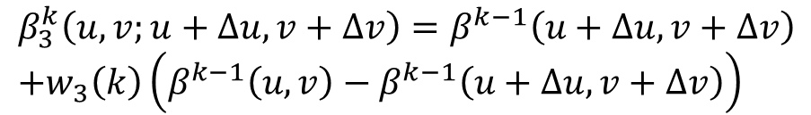
Weight 3
100
90
90
90
110
90
$$w_{3}=2$$
$$β^{k−1}$$
$$β^{k}$$
10
Iteration process
Color difference
of input image
$$Δα$$
Exaggerate the color difference
$$β_{3}^{k}\left(u,v;u+∆u,v+∆v\right)=β^{k−1}\left(u+∆u,v+∆v\right)$$
$$+w_{3}\left(k\right)\left(β^{k−1}\left(u,v\right)−β^{k−1}\left(u+∆u,v+∆v\right)\right)$$
Color difference of current iteration
$$m_{3}^{k_{max}−k}$$
Iteration number
Maximum iteration number
User-defined parameter (1~)
Notes:
1:10

Slide 11


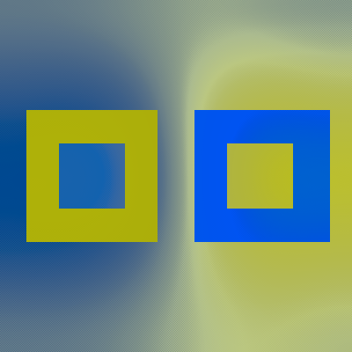
Result [Protanopia]
Trichromat image
of input image
Dichromat image
of input image
Dichromat image
of output image
Notes:
0:32

Slide 12

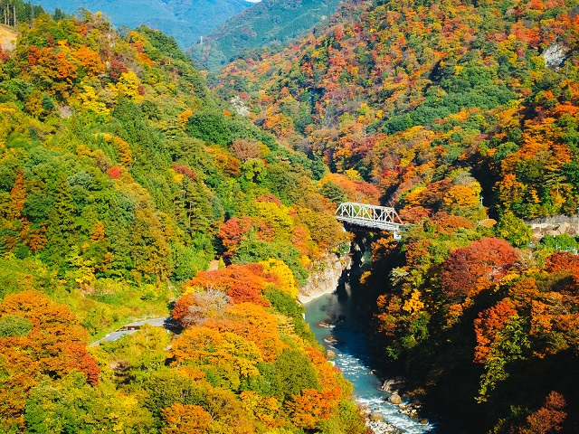
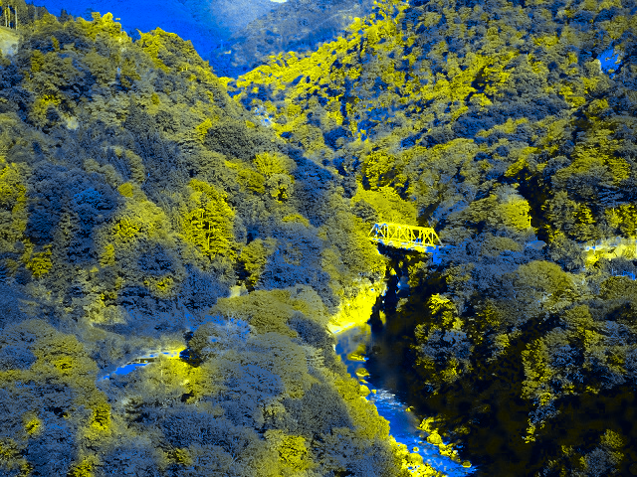



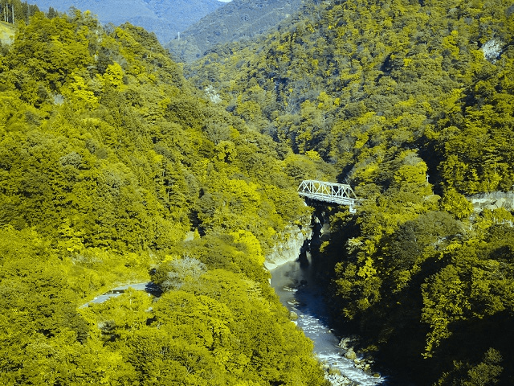
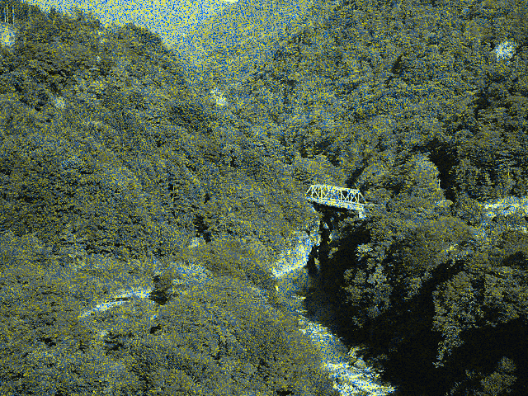
Result [Protanopia]
Trichromat image of input image
Dichromat image of output image
Dichromat image of input image
Intermediate image during iteration
10000 iterations
Notes:
1:07

Slide 13
Conclusion
Summary
Color exaggeration for dichromats
Exaggerate color difference between neighboring pixels
User can adjust the amount of color exaggeration using the parameters
Color difference at color boundary is exaggerated as much as possible
The problem to be solved in the future
Parameter tuning problem: m₁, m₂, m₃
Notes:
0:46

Slide 14
Daisuke Miyazaki 2024
Creative Commons Attribution 4.0 International License.
http://www.info.hiroshima-cu.ac.jp/~miyazaki/
Daisuke Miyazaki, Takuro Namiki, "Image Enhancement for Dichromats by Weighting the Color Difference Between Neighboring Pixels," NICOINT2024, 2024.06

