Slide 1
Mixing paints for generating metamerism art under 2 lights and 3 object colors
Daisuke Miyazaki Kanami Takahashi
Masashi Baba Hirooki Aoki
Ryo Furukawa Masahito Aoyama
Shinsaku Hiura

Slide 2
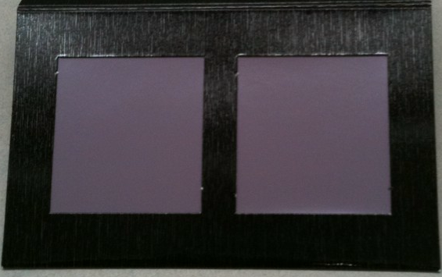
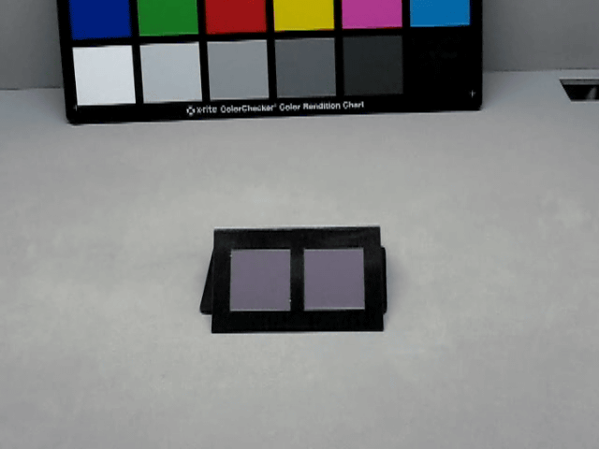
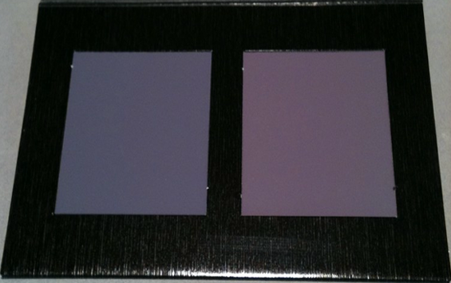
Metamer sets
Introduction(1/3)
Perception(3)
Reflection model(5)
Cost function(4)
Experiment(3)
Light 1
R: 93
G: 79
B: 94
R: 93
G: 79
B: 93
Same
Light 2
R: 81
G: 77
B: 98
R: 99
G: 82
B: 101
Different

Slide 3
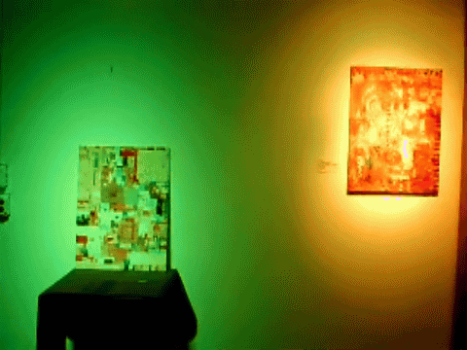

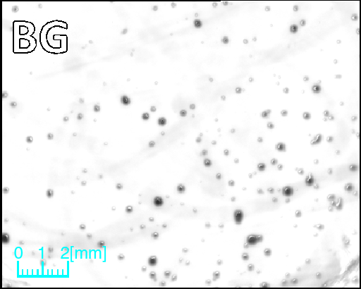
Related work
Introduction(2/3)
Perception(3)
Reflection model(5)
Cost function(4)
Experiment(3)
Art [Valluzzi 2012]
Watermark [Bala, Braun, Loce 2009]
Microbiology [Kobayashi, Yamada,
Hiraishi, Nakauchi 2012]
[Our work]
Intentionally cause expected metamerism for oil painting art

Slide 4
Purpose
Introduction(3/3)
Perception(3)
Reflection model(5)
Cost function(4)
Experiment(3)
Light 1
Light 2
Mix paint 2
Mix paint 1
Mix paint 3

Slide 5
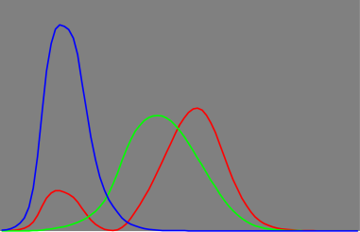
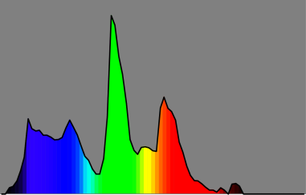
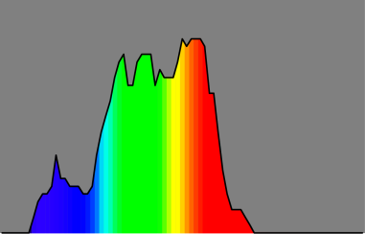

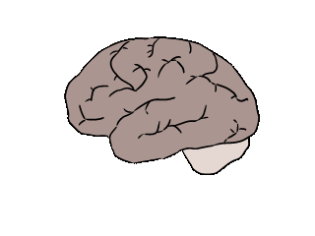
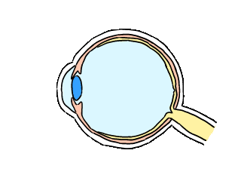
Human perception
Introduction(3)
Perception(1/3)
Reflection model(5)
Cost function(4)
Experiment(3)
800nm
400nm
CIE-XYZ value
Spectral response
Light
Object

Slide 6

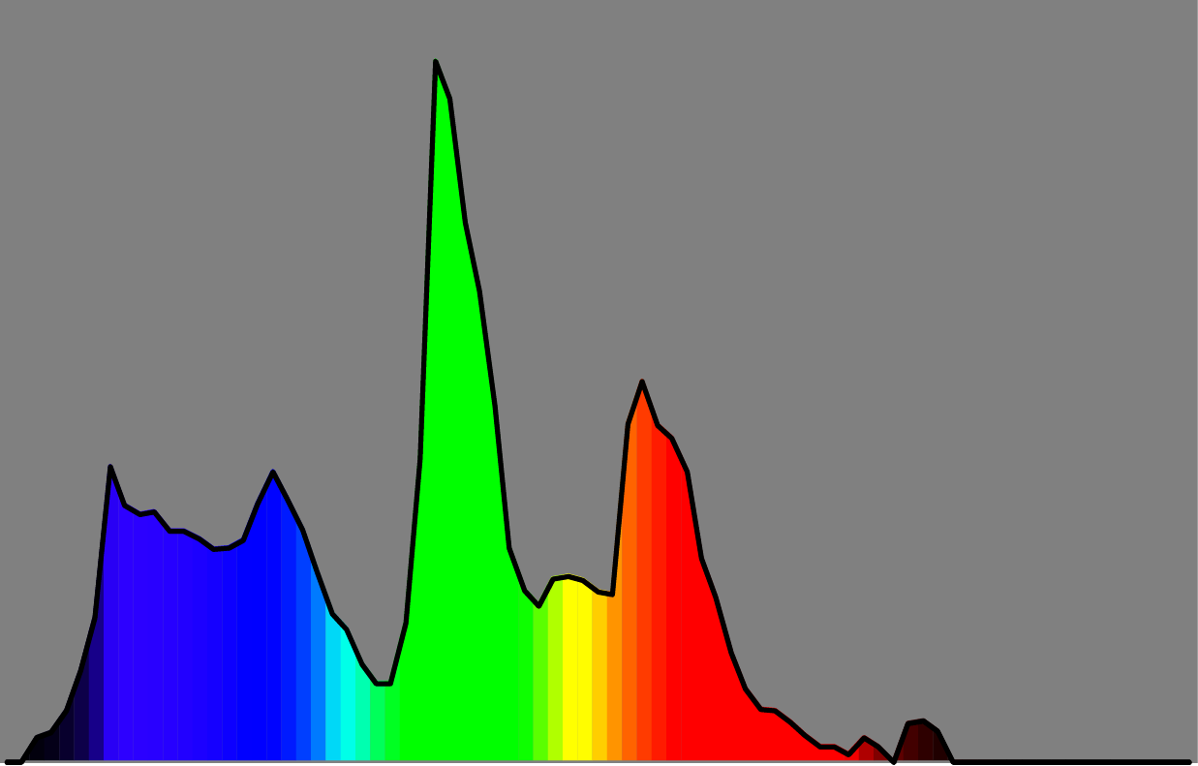

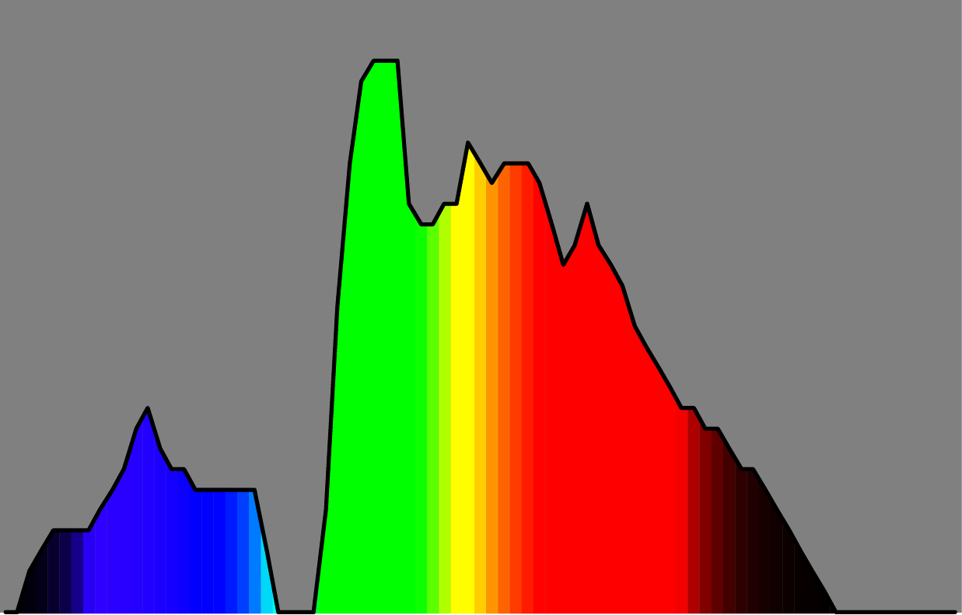
Spectral distribution: same color
Introduction(3)
Perception(2/3)
Reflection model(5)
Cost function(4)
Experiment(3)
X: 0.36
Y: 0.50
Z: 0.14
Color matching func.
(CIE-XYZ)
Light 1
Paint 1
X: 0.36
Y: 0.50
Z: 0.14
Color matching func.
(CIE-XYZ)
Light 1
Paint 2

Slide 7
Spectral distribution: different color
Introduction(3)
Perception(3/3)
Reflection model(5)
Cost function(4)
Experiment(3)
X: 0.35
Y: 0.48
Z: 0.17
Color matching func.
(CIE-XYZ)
Light 2
Paint 1
X: 0.38
Y: 0.46
Z: 0.16
Color matching func.
(CIE-XYZ)
Light 2
Paint 2

Slide 8
Reflection model of mixing paints
Introduction(3)
Perception(3)
Reflection model(1/5)
Cost function(4)
Experiment(3)
Previous model: linear model
Our model: exponential model
[Finlayson, Morovic 2005]
[Alsam, Finlayson 2007]
[Miyazaki, Nakamura, Baba, Furukawa,
Aoyama, Hiura, Asada 2012]
d: spectral reflectance
w: mixing weight
Elegant relationship
Our model = linear model in logarithmic space

Slide 9
Reflectance: Paint 1
Introduction(3)
Perception(3)
Reflection model(2/5)
Cost function(4)
Experiment(3)
Incident light
Diffusely reflected light
10
d₁ =

Slide 10
Reflectance: Paint 2
Introduction(3)
Perception(3)
Reflection model(3/5)
Cost function(4)
Experiment(3)
Incident light
Diffusely reflected light
10
d₂ =

Slide 11
Reflectance: Paint 1 & 2
Introduction(3)
Perception(3)
Reflection model(4/5)
Cost function(4)
Experiment(3)
Incident light
Diffusely reflected light
7
3
1
1
Reflectance =
d₁
10
d₂
10

Slide 12
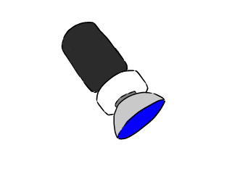
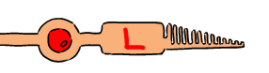
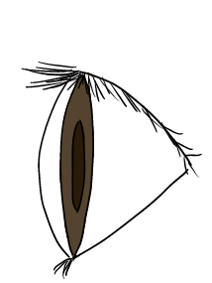
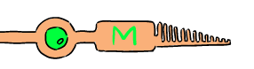
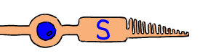
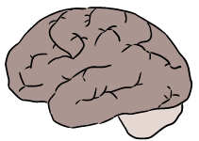
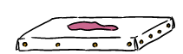
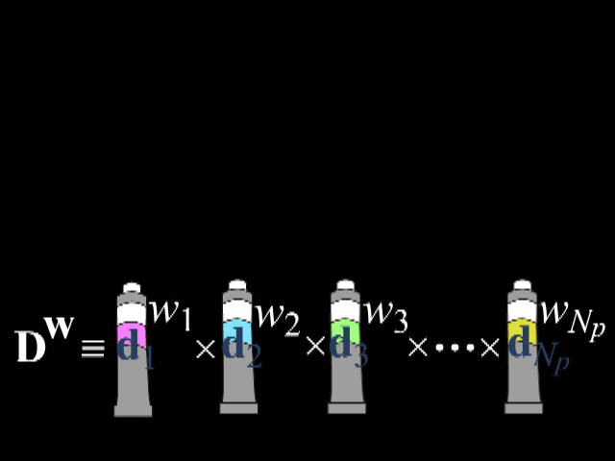
Introduction(3)
Perception(3)
Reflection model(5/5)
Cost function(4)
Experiment(3)
Database D
Recognized color
PED^{w}
Light E
Mixing weight w
Perception P

Slide 13
Cost function
Introduction(3)
Perception(3)
Reflection model(5)
Cost function(1/4)
Experiment(3)
w
w
w
D
1
D
3
D
2
Paint 1
Paint 3
Paint 2

Slide 14
Cost function

Slide 15
Cost function
Introduction(3)
Perception(3)
Reflection model(5)
Cost function(2/4)
Experiment(3)
E₁
w
w
w
PE D
1
PE D
3
PE D
2
1
1
1
Paint 1
Paint 3
Paint 2
E₂
w
w
w
PE D
1
PE D
3
PE D
2
2
2
2
Paint 1
Paint 3
Paint 2

Slide 16
Cost function
w
w
w
PE D
1
w
2
PE D
PE D
PE D
3
min
3
1
max
1
1
1
w
w
w
w
PE D
PE D
PE D
max
1
PE D
min
2
3
2
2
3
2
2

Slide 17
Cost function
Introduction(3)
Perception(3)
Reflection model(5)
Cost function(3/4)
Experiment(3)
w
w
w
w
min
PE D
1
PE D
3
max
PE D
3
PE D
2
1
1
1
1
w
w
w
w
max
PE D
1
PE D
3
min
PE D
3
PE D
2
2
2
2
2

Slide 18
Cost function
Introduction(3)
Perception(3)
Reflection model(5)
Cost function(4/4)
Experiment(3)
w
w
2
w
w
0.5
arg min
PE D
1
PE D
3
PE D
3
PE D
2
1
1
1
1
w₁, w₂, w₃
w
w
0.5
w
w
2
PE D
1
PE D
3
PE D
3
PE D
2
2
2
2
2

Slide 19
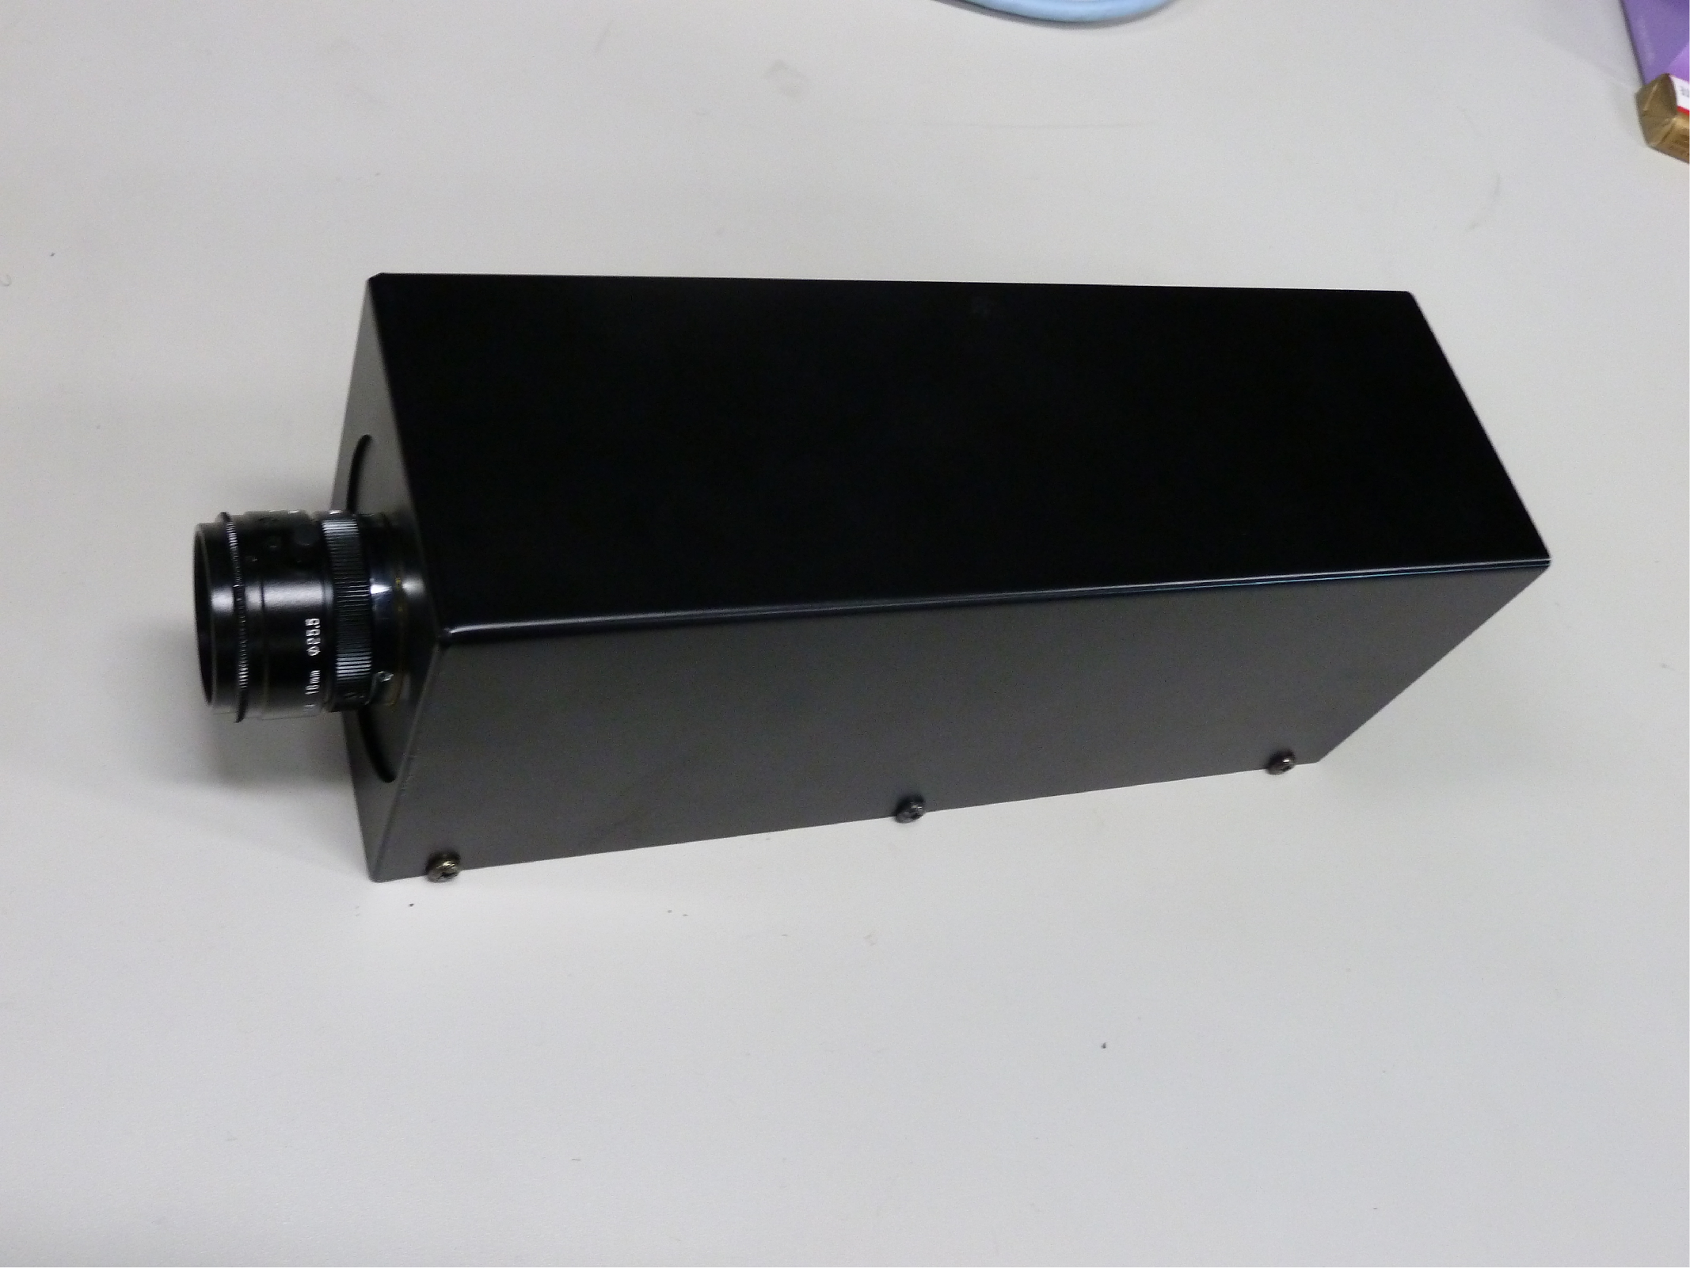
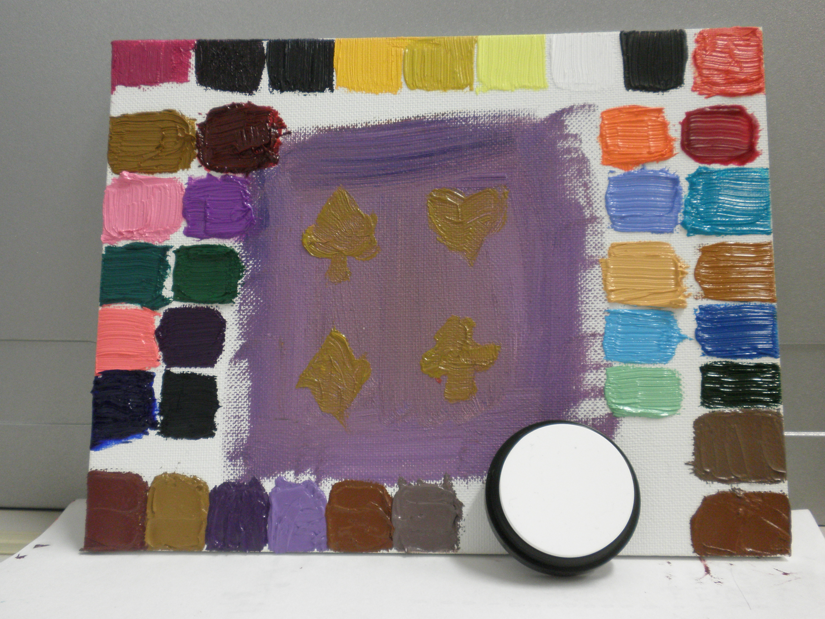
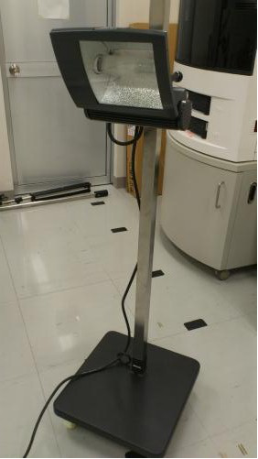
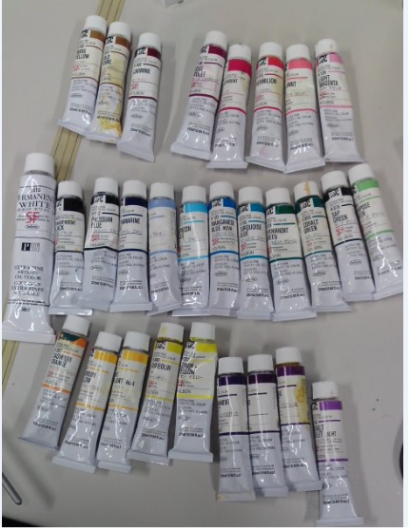

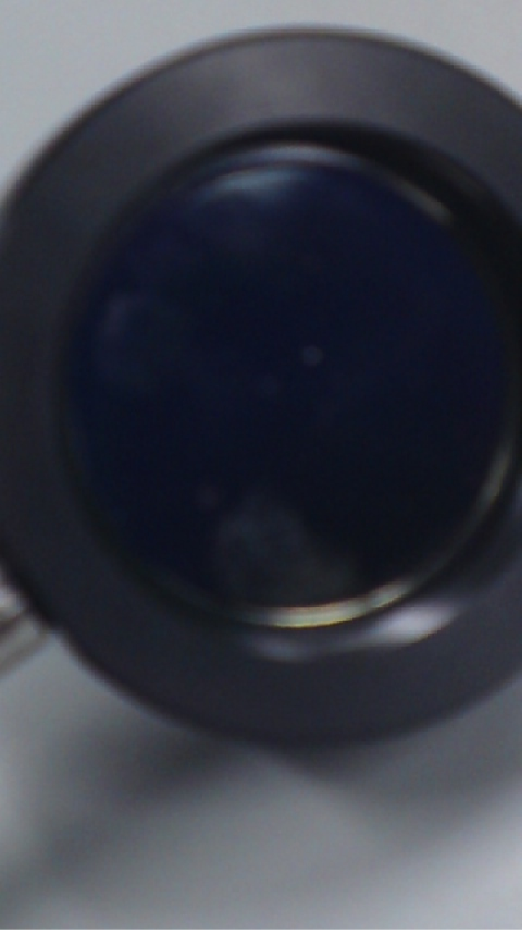
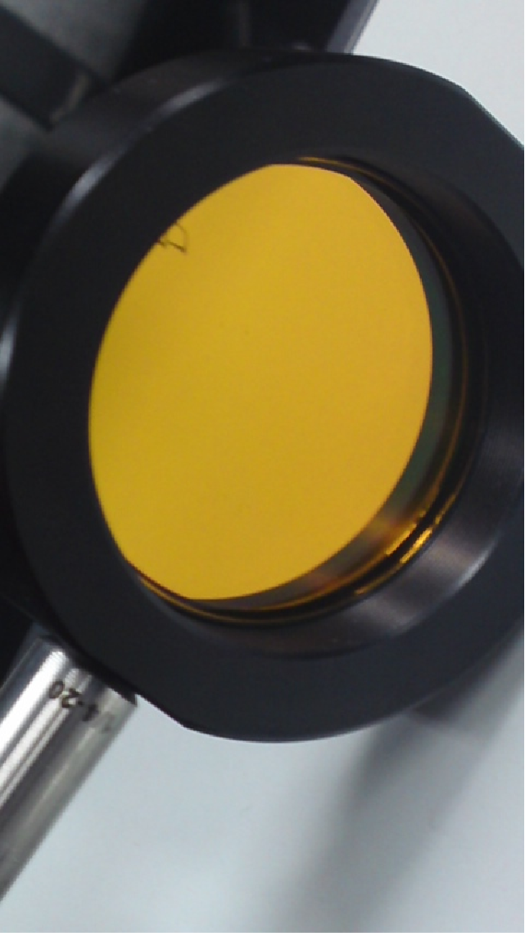
Experimental equipments
Introduction(3)
Perception(3)
Reflection model(5)
Cost function(4)
Experiment(1/3)
Hyper-spectral camera
Oil paints
Artificial sunlight
Narrow-band
filter
Diffuse white
reflectance standard

Slide 20
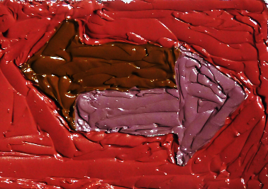
Result
Introduction(3)
Perception(3)
Reflection model(5)
Cost function(4)
Experiment(2/3)
Synthesized paint 2
Synthesized paint 1
Synthesized paint 3

Slide 21
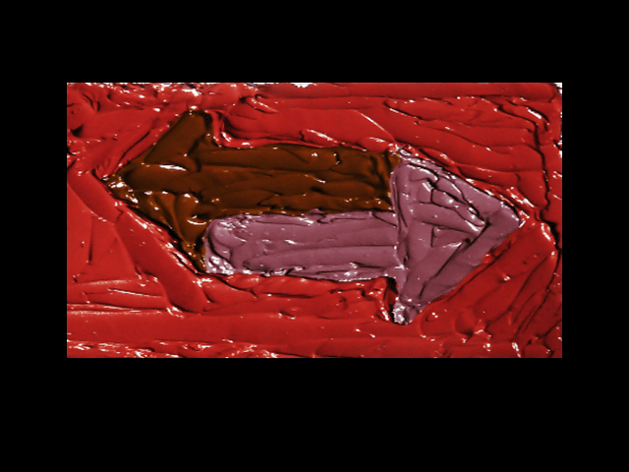

Slide 22
Daisuke Miyazaki 2013
Creative Commons Attribution 4.0
International License.
http://www.cg.info.hiroshima-cu.ac.jp/~miyazaki/
Daisuke Miyazaki, Kanami Takahashi, Masashi Baba, Hirooki Aoki, Ryo Furukawa, Masahito Aoyama, Shinsaku Hiura, “Mixing paints for generating metamerism art under 2 lights and 3 object colors,” CPCV, 2013.

